Slide 1
Fremantle Ports Development
Sami Zouad
General Manager Strategy, Planning and Performance
4 September 2025

Slide 2
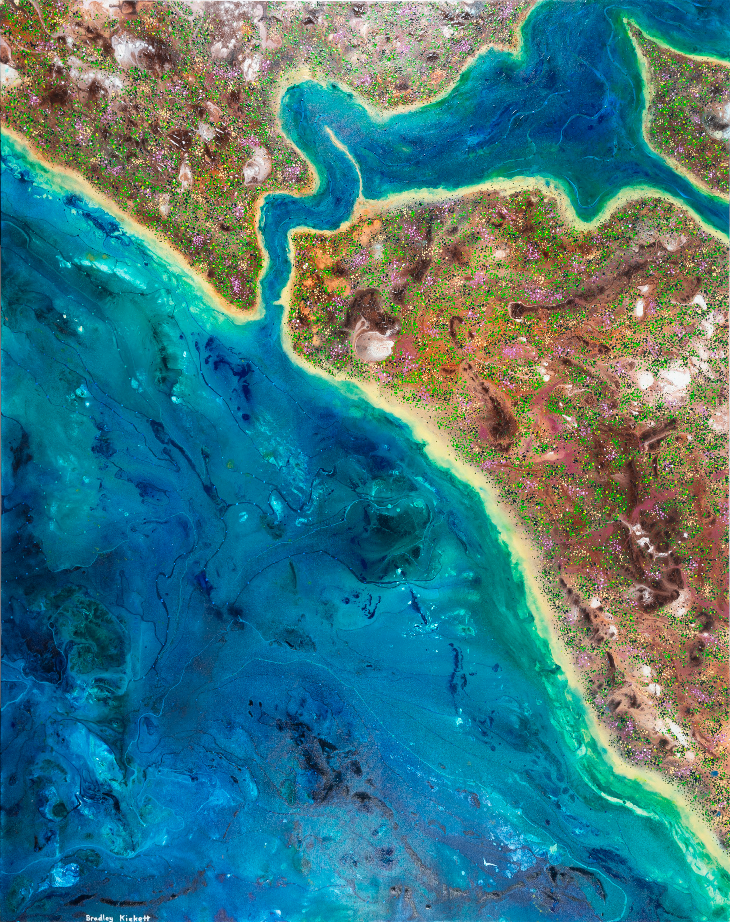
Fremantle Ports acknowledges the Noongar people as the Traditional Custodians of port land and waters and pays respect to their Elders past and present.

Slide 3
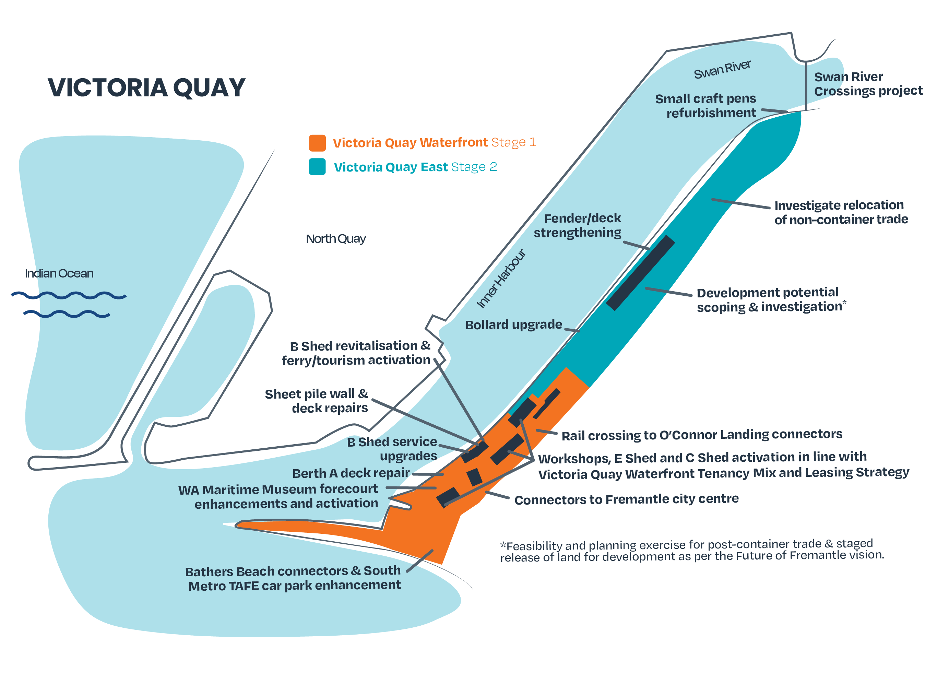
TRANSFORMATION
A vibrant waterfront destination for tourism and trade
Revitalise existing buildings and attract tenants that will bring more visitors to Victoria Quay.
Enhance the public realm to provide a safer, improved visitor experience.
Investigate and enable the potential future use and redevelopment of the eastern end of Victoria Quay in alignment with the Future of Fremantle vision.

Slide 4
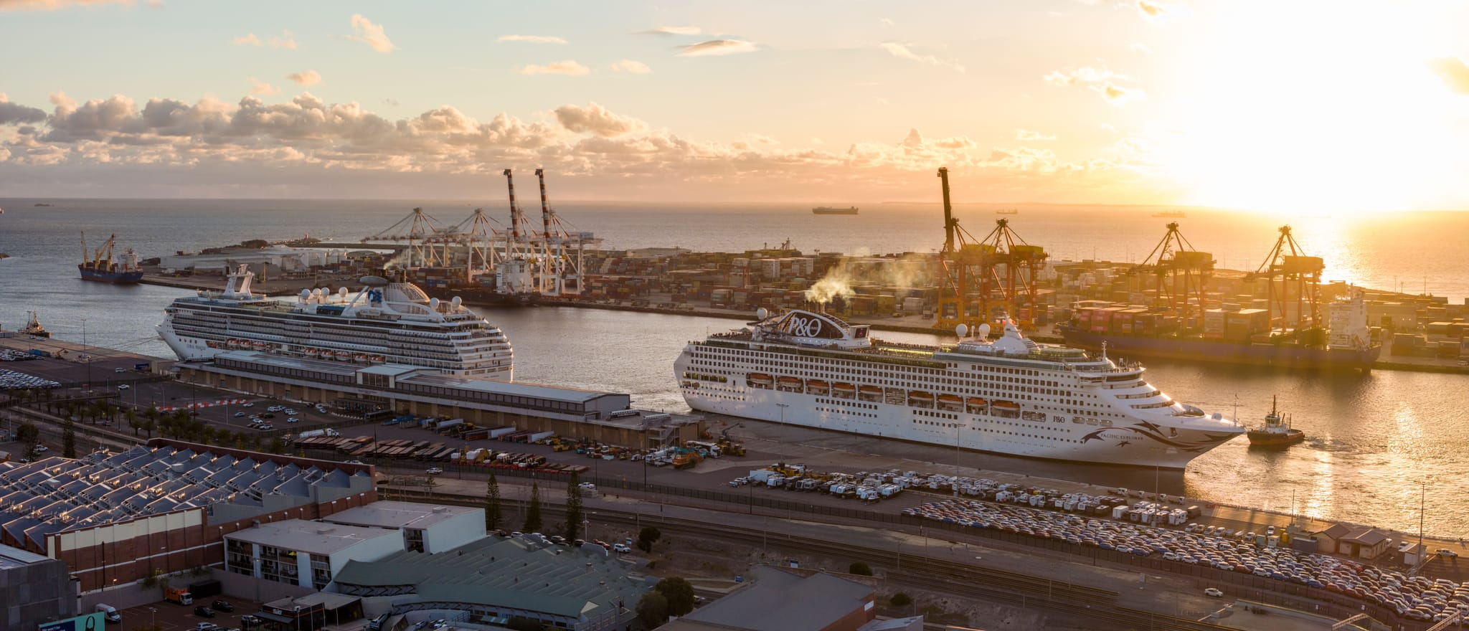
Cruise

Slide 5

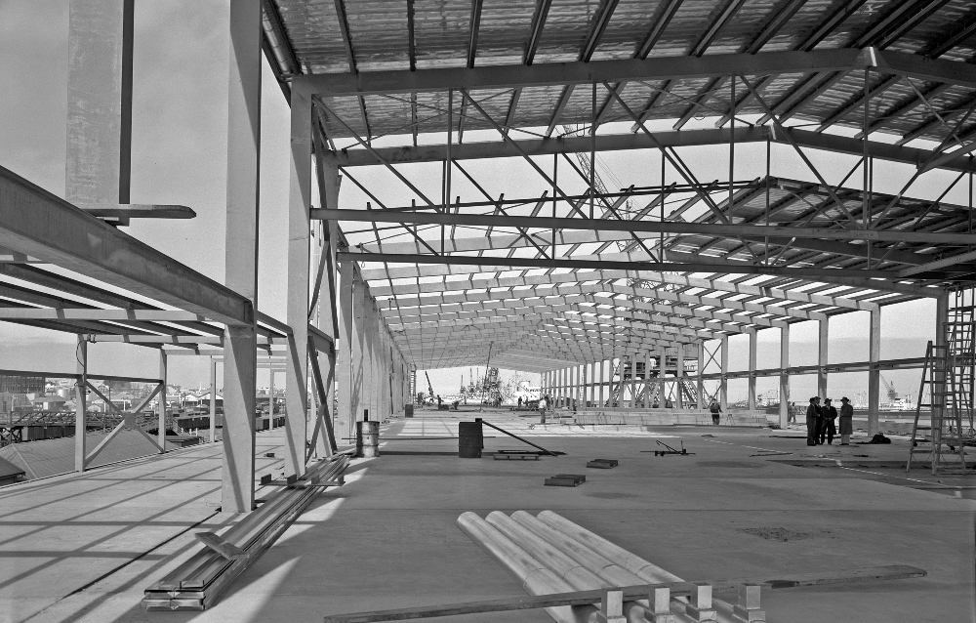
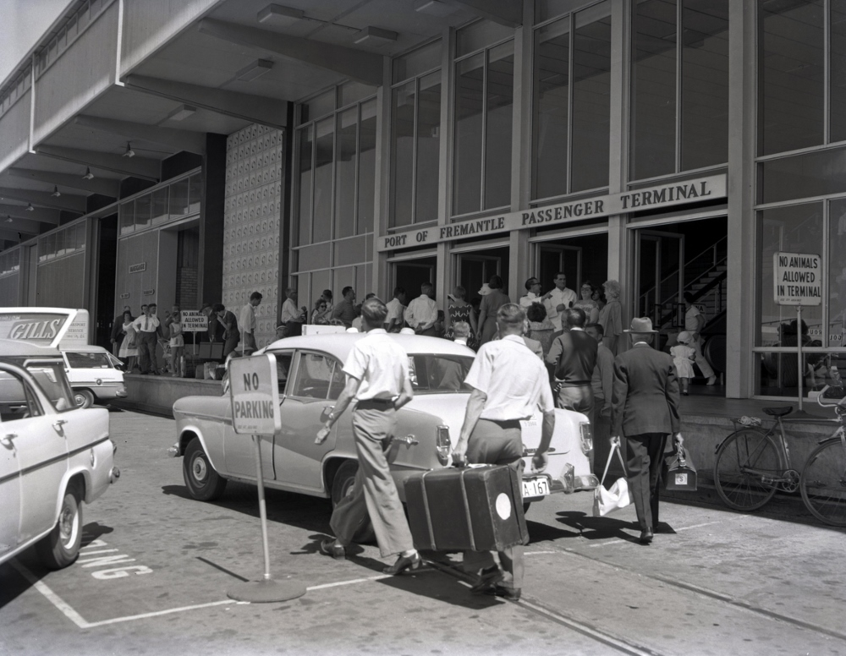
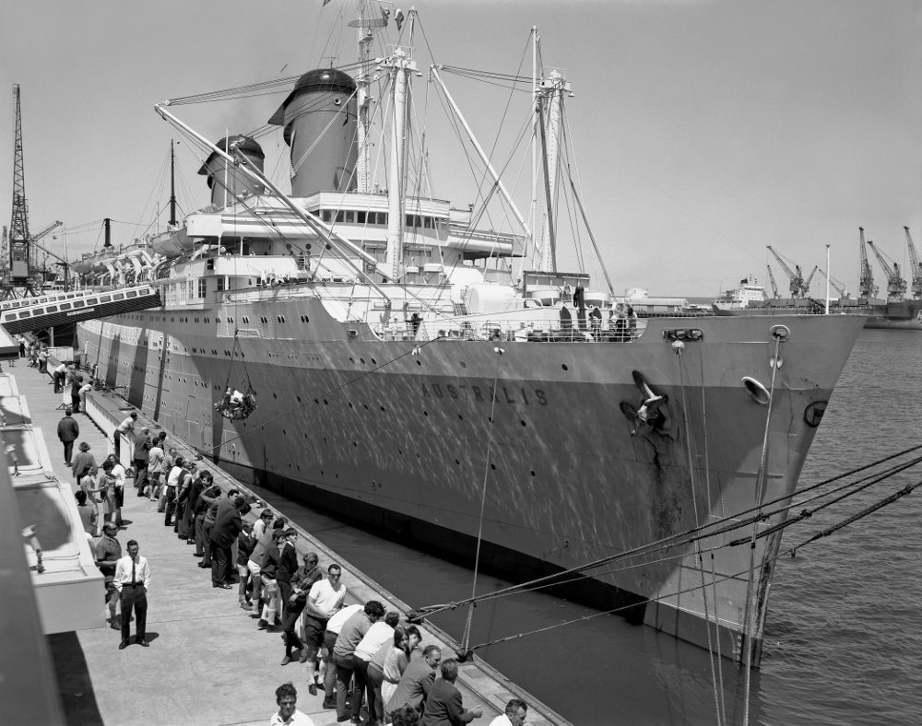
History – Gateway to WA
Building of Fremantle Passenger Terminal - 1959
Post-WWII wave of immigration.
100, 000s of migrants and Fremantle Passenger Terminal provided their first impression of Australia.
At its peak in the mid-1960s, the terminal was servicing about 200,000 passengers a year
Passengers arrive at FPT - 1963
Migrant liner Australia – arrival from Britain - 1968

Slide 6
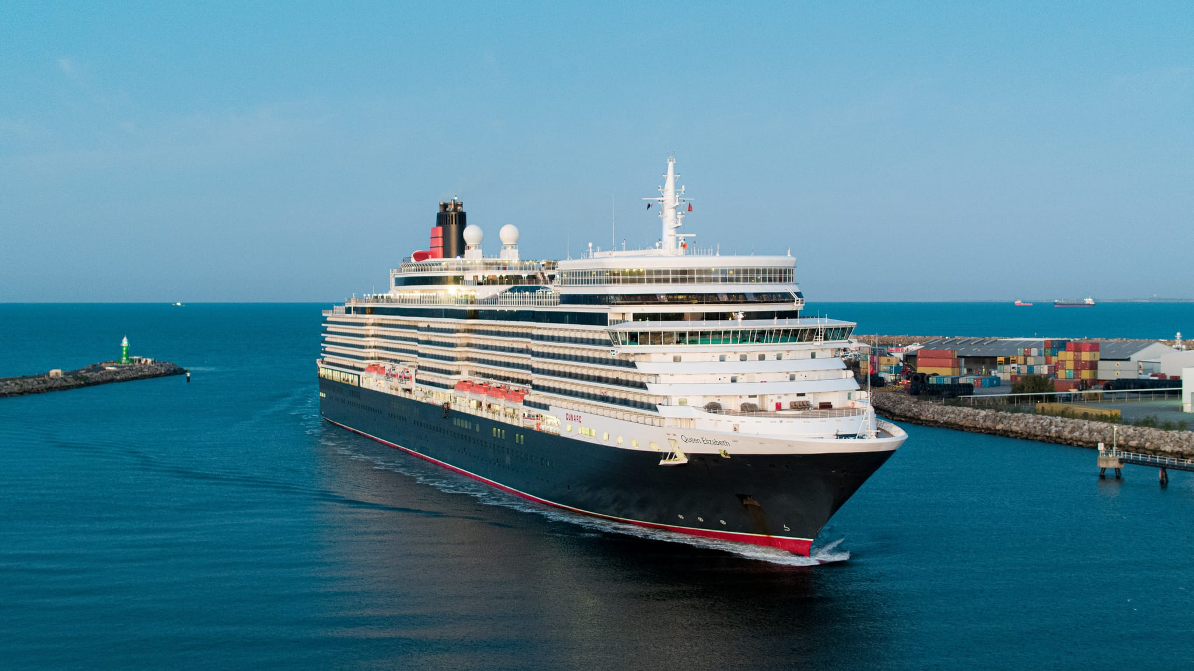
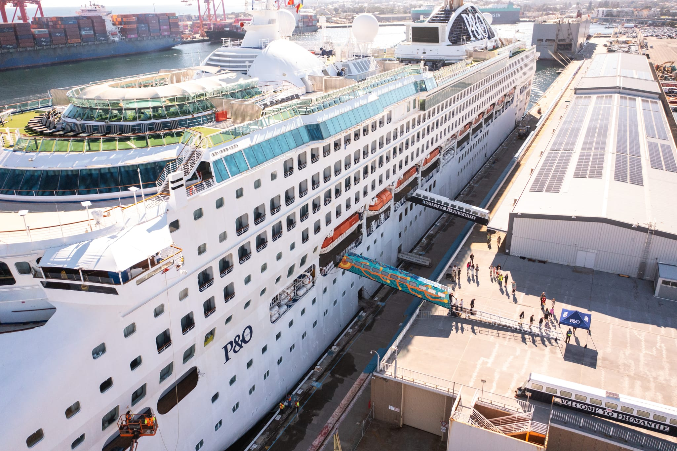
Today
One of Australia's largest cruise terminals - capable of berthing 2 cruise liners
27 cruise ships welcomed (2024-25)
Economic Impact –
Value added – $145.6 million (2023-24)
Jobs – 925 (2023-24)
Investment in cruise berth fenders to ensure continuity of trade

Slide 7
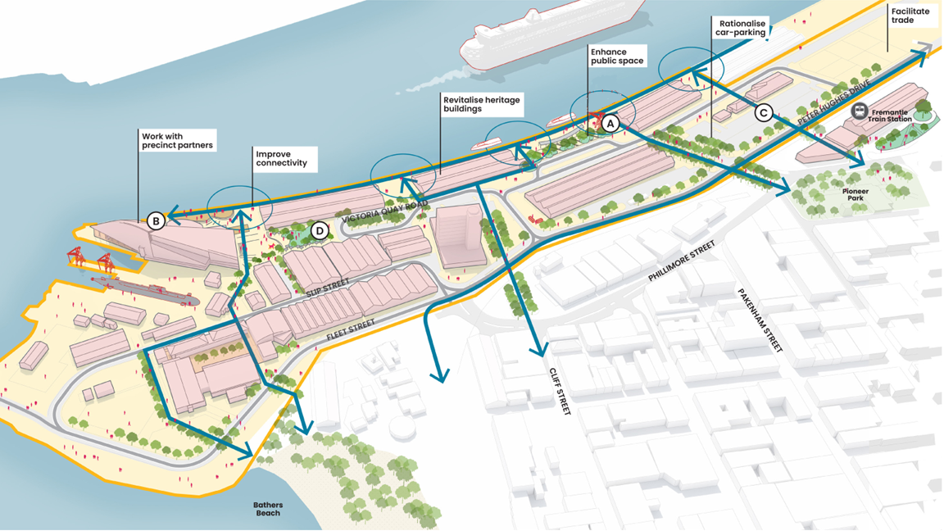
Victoria Quay
Tourism & Trade

Slide 8
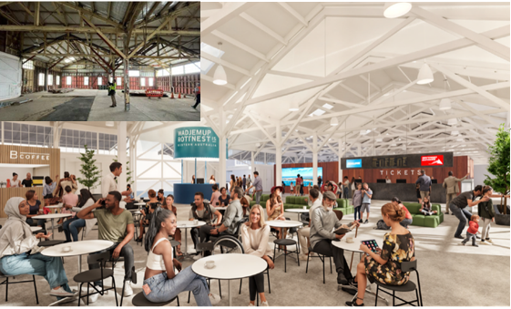
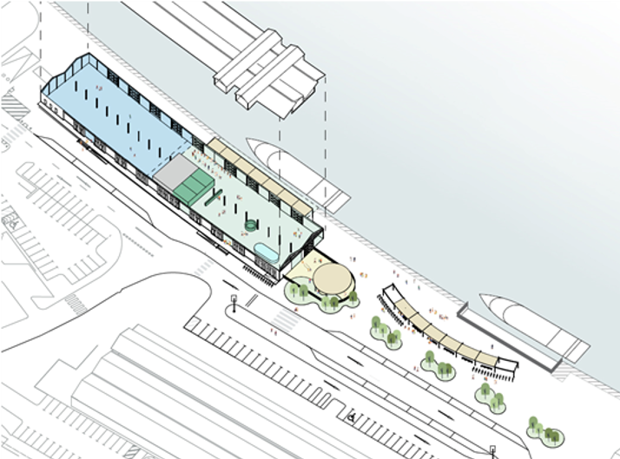
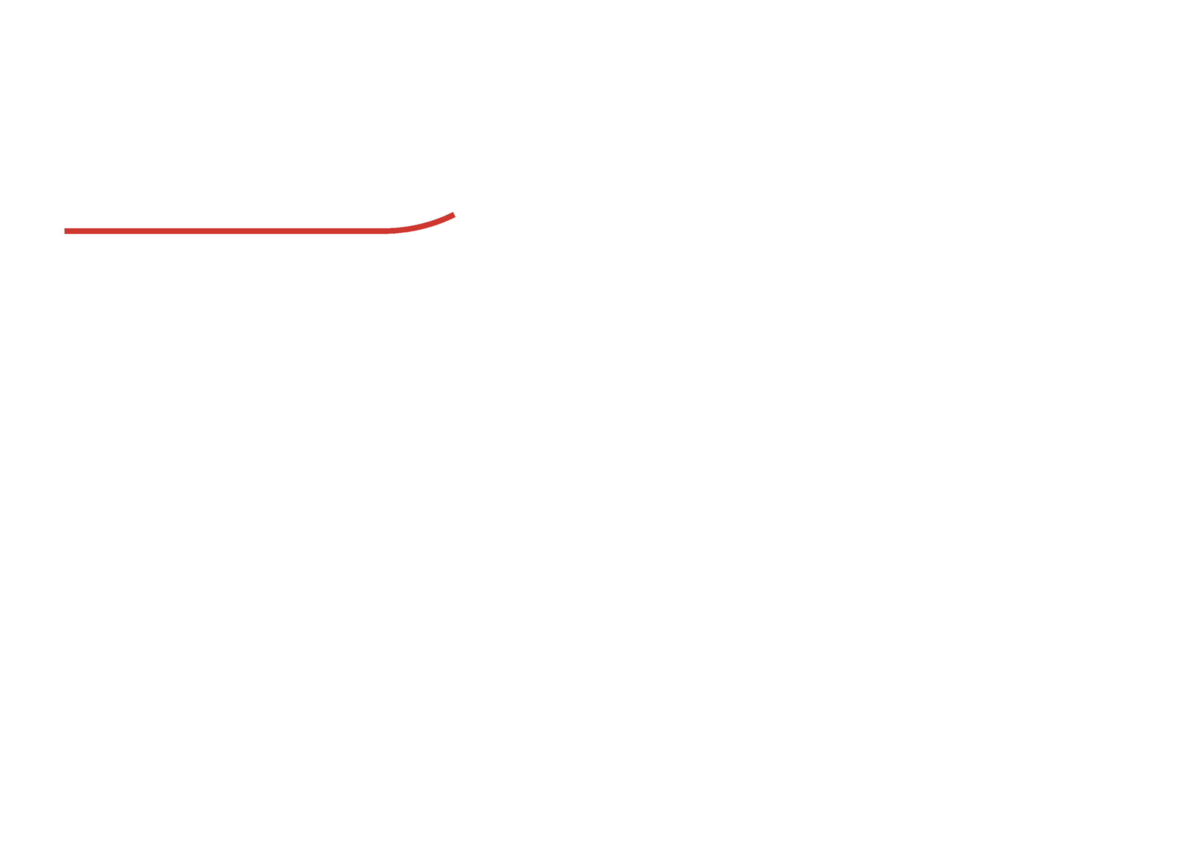
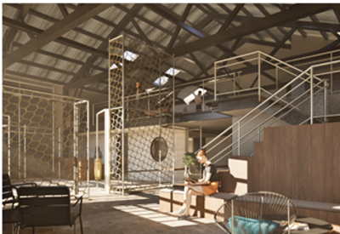
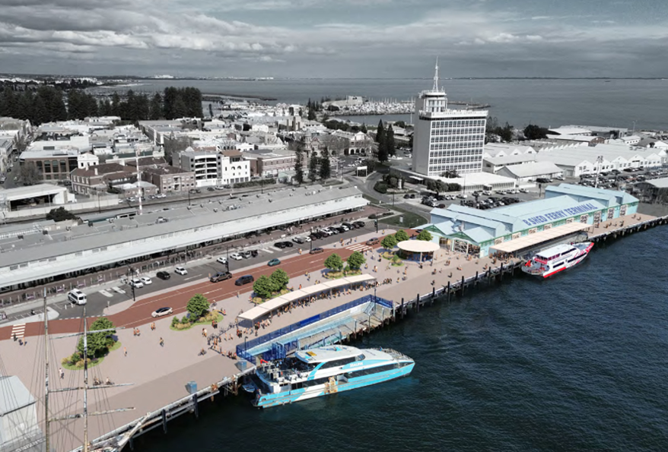
^{Destination} ^{development}
^{Revitalise} ^{existing buildings}
Embedding new uses to create a dynamic and resilient waterfront destination; and fit for purpose infrastructure that unlocks new opportunities for redevelopment, cultural exchange and jobs for the future.

Slide 9
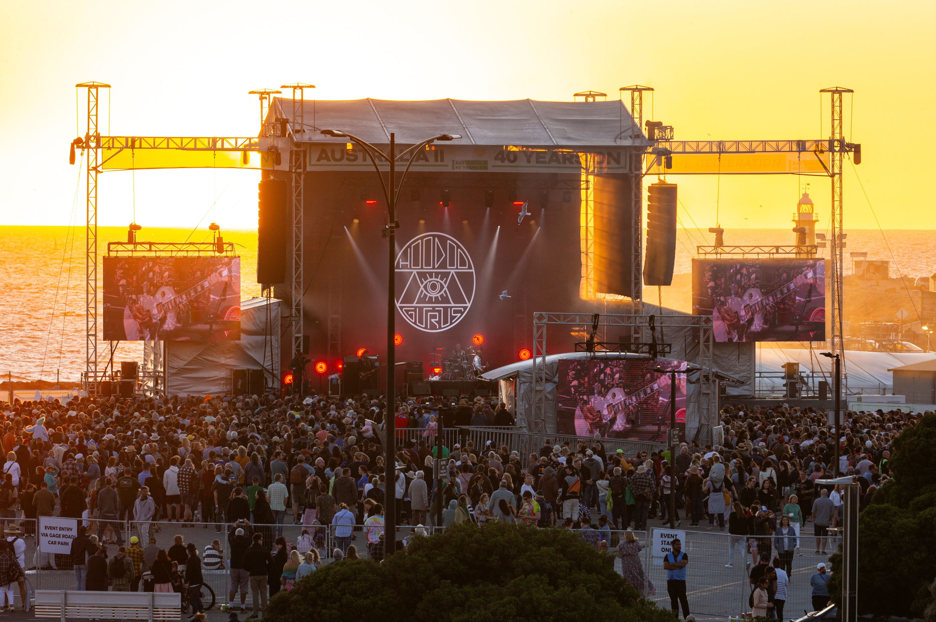
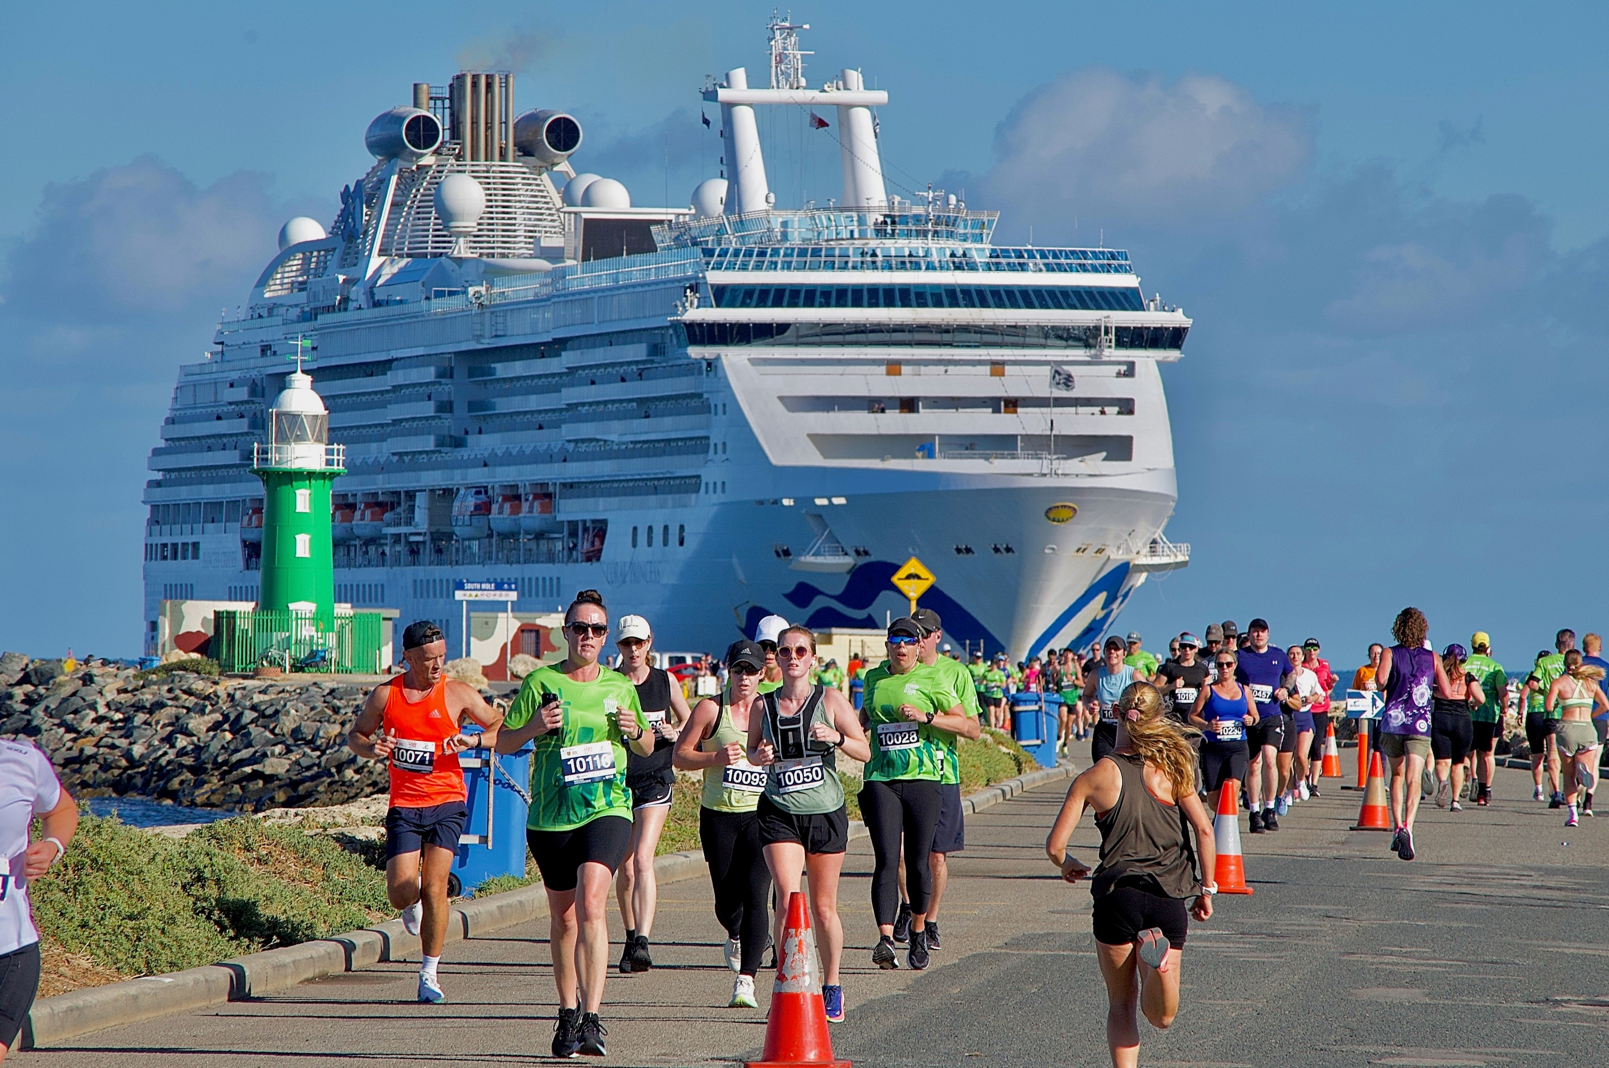
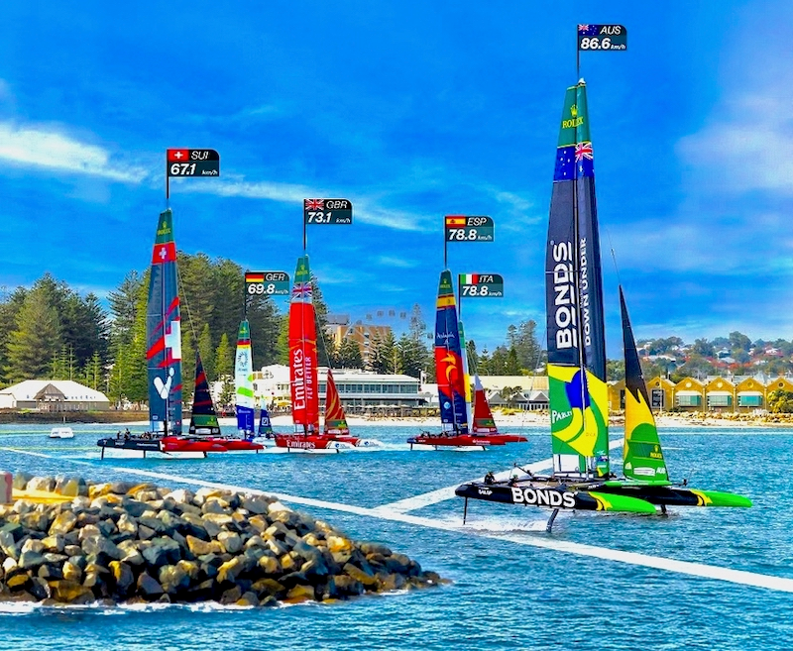
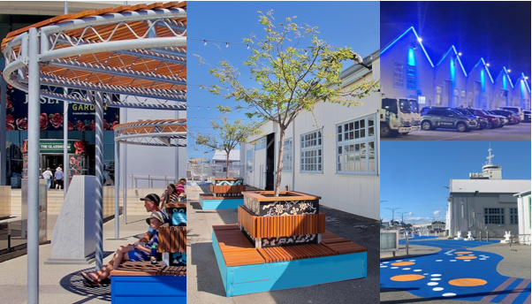
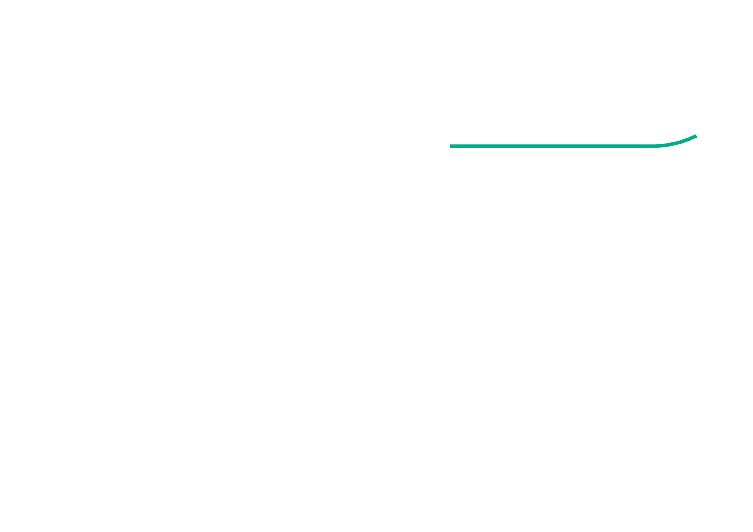
^{Public space and activation}
Enhance public space and activation
America’s Cup – 40 years on
Harbour Master Classic
Investing in enhanced public spaces and strategic events to reposition VQ as a place which brings people together to meet and connect.
SailGP
WAMM Forecourt
(Source: Roel Loopers)

Slide 10
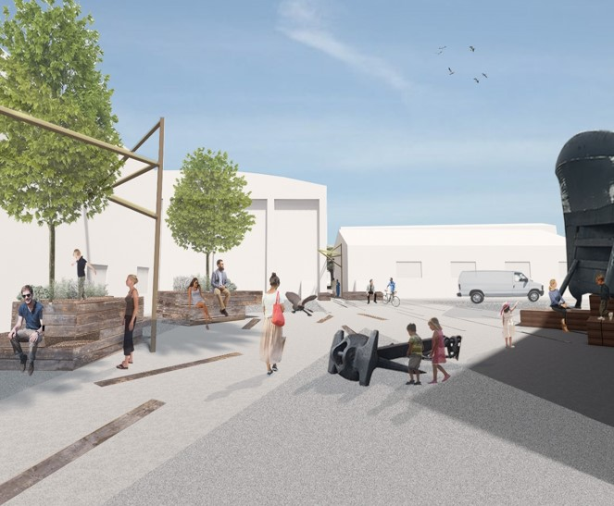
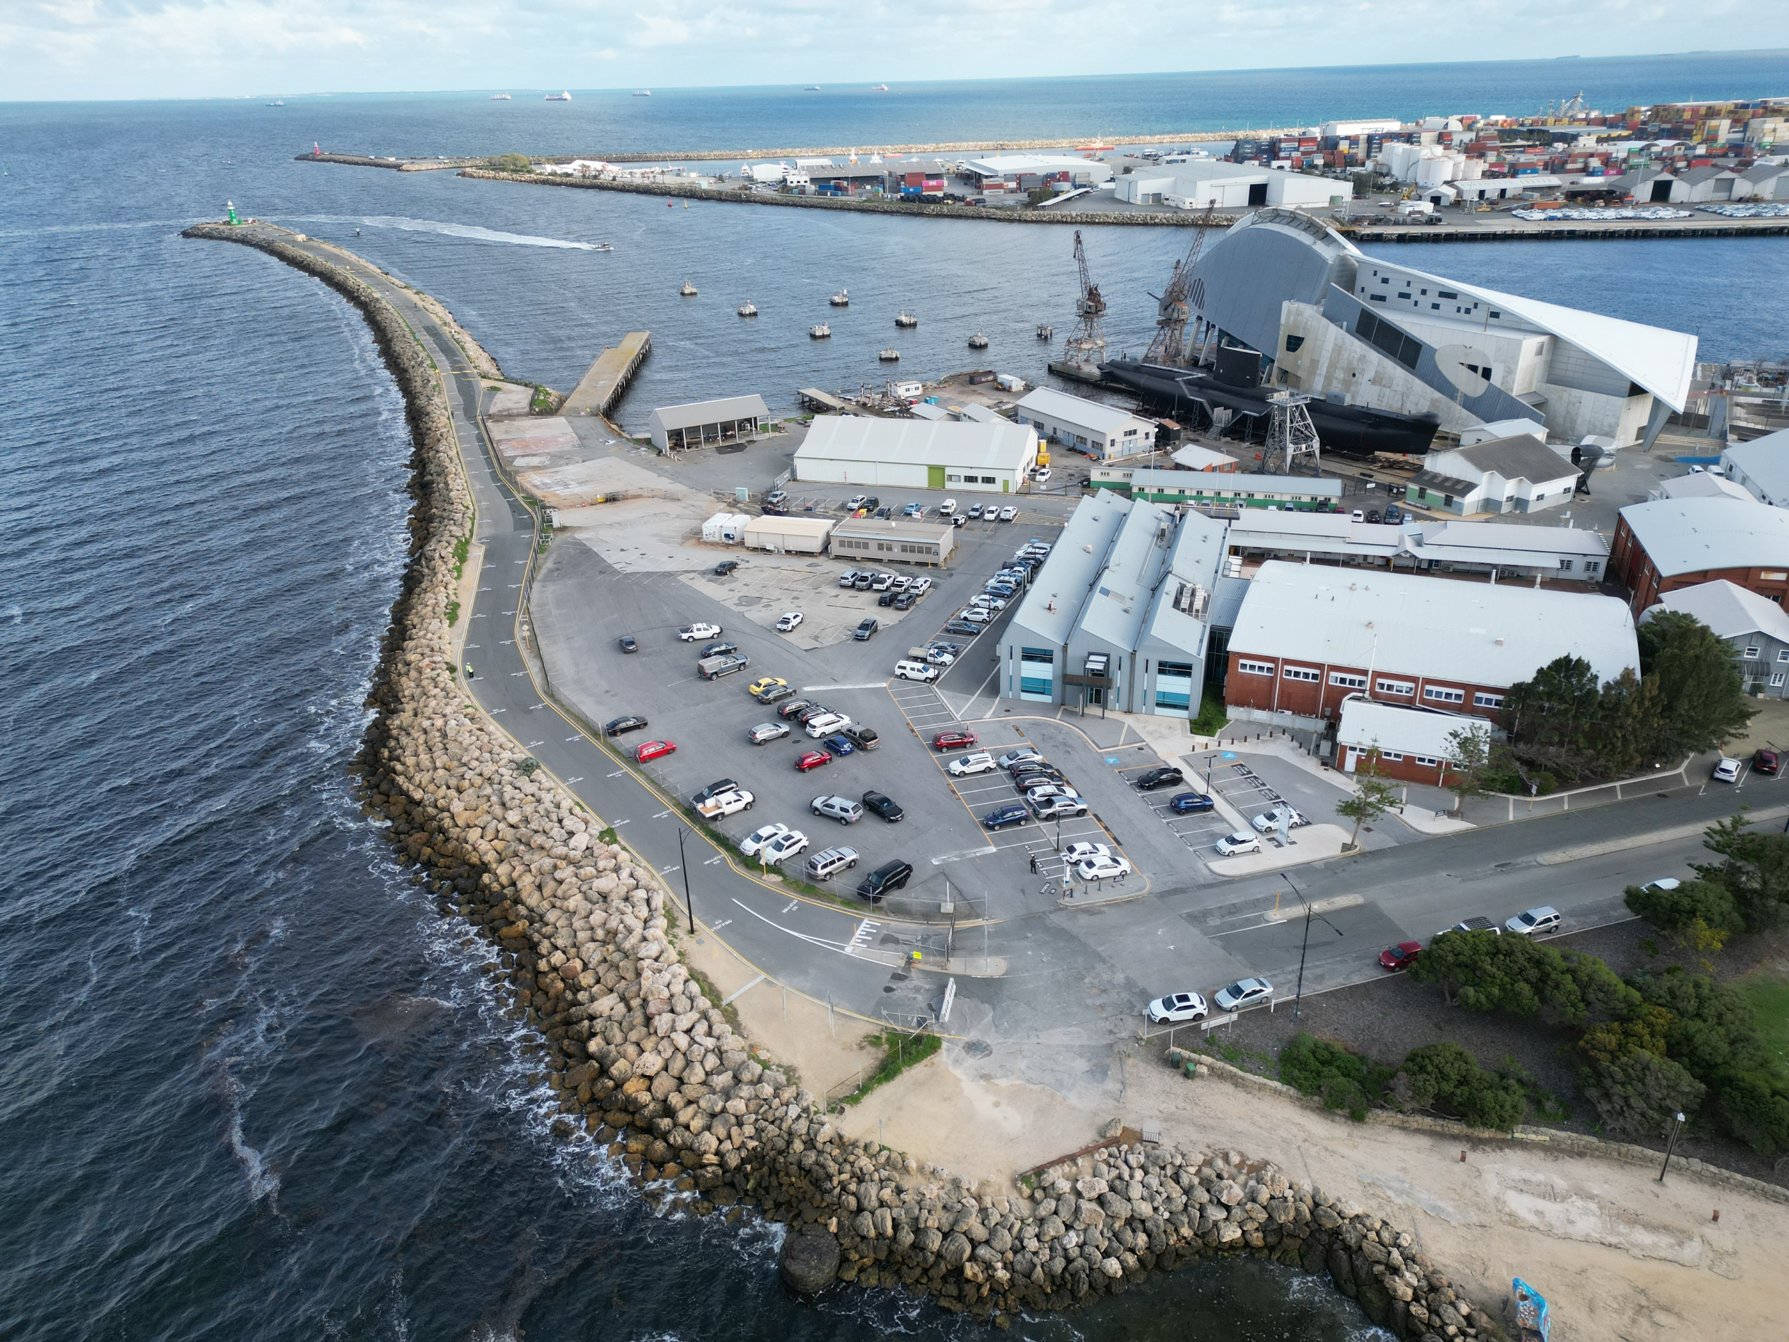

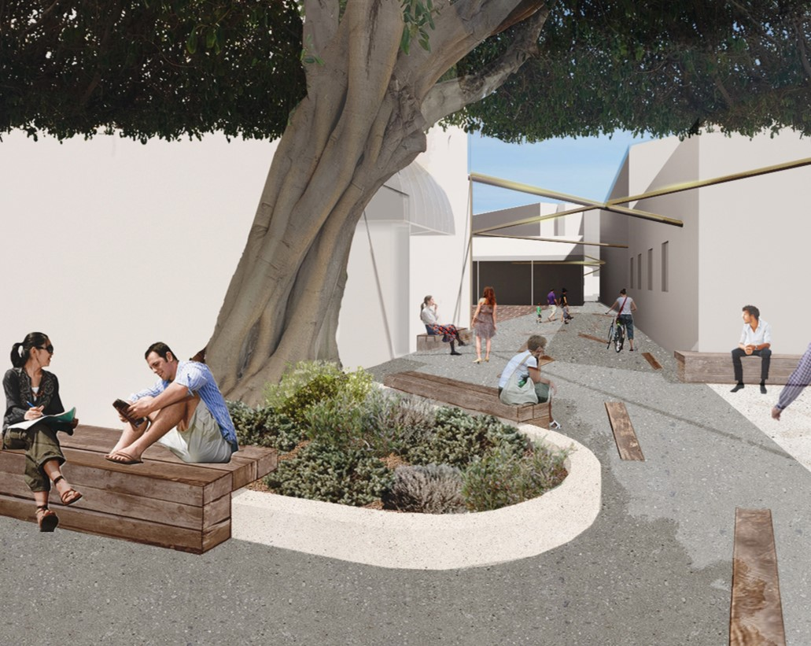
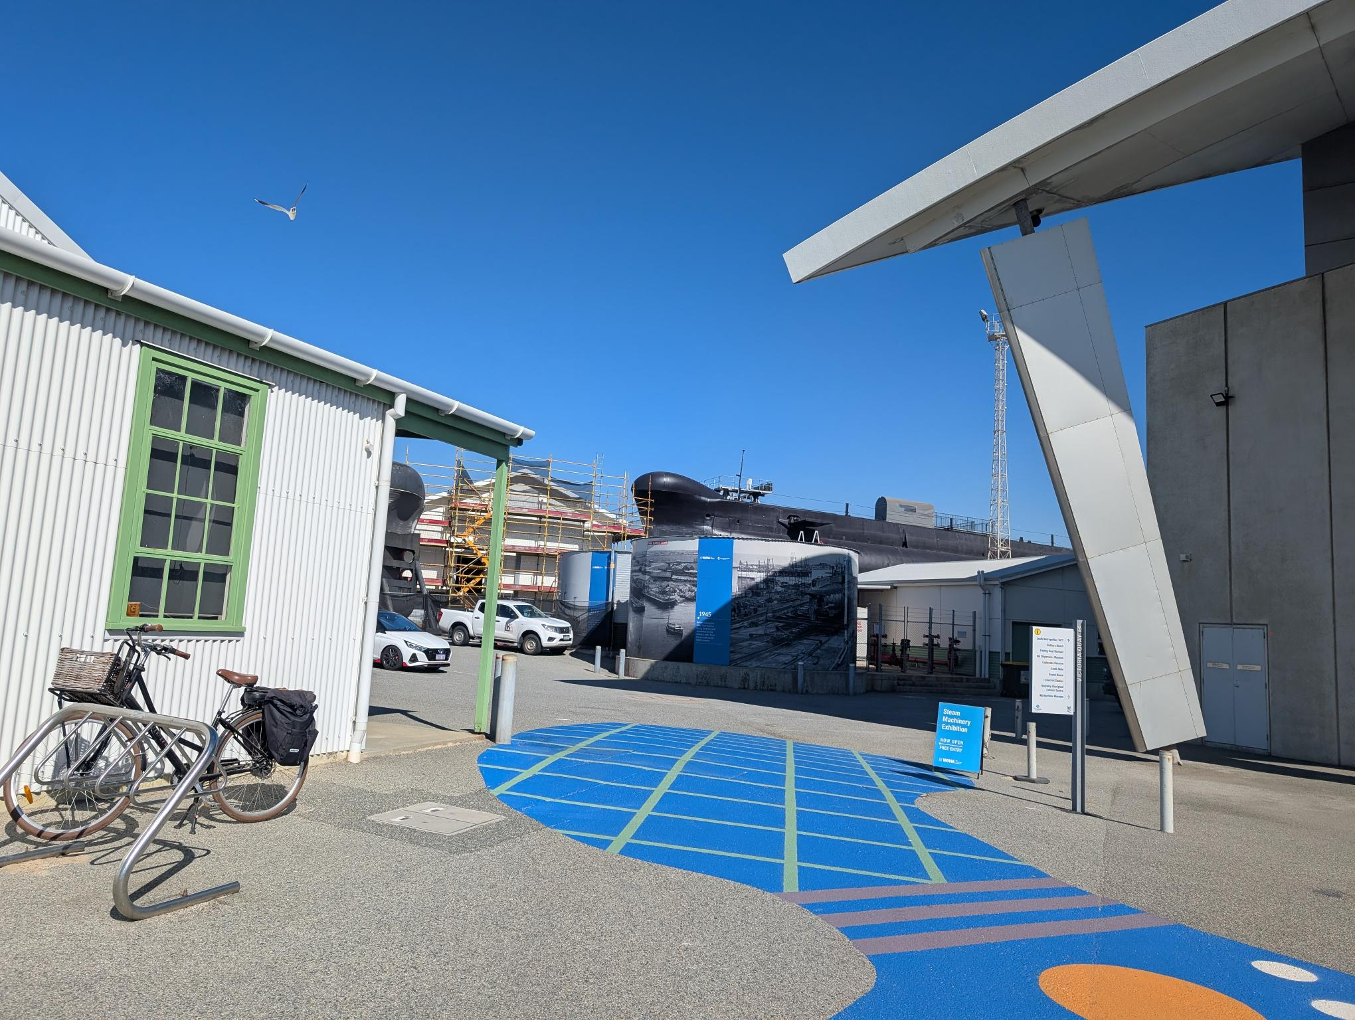
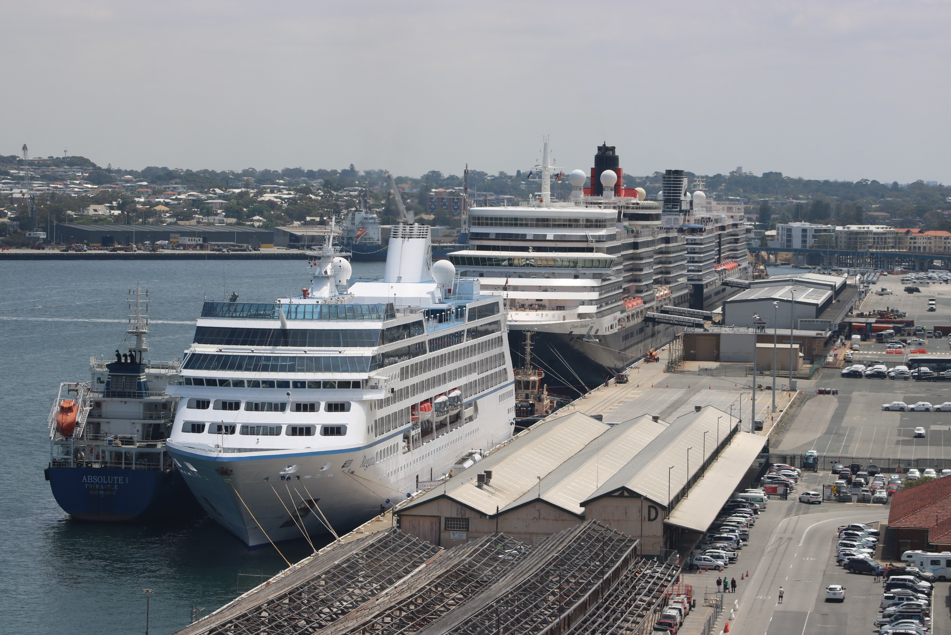
^{Connections} ^{and movement}
^{Improve urban connectivity}
Planning for innovative transport solutions that better link VQ with the Fremantle city centre, reasonably balance the facilitation of trade and reprioritise the seamless and safe movement of pedestrians, cyclists and public transport users.

Slide 11
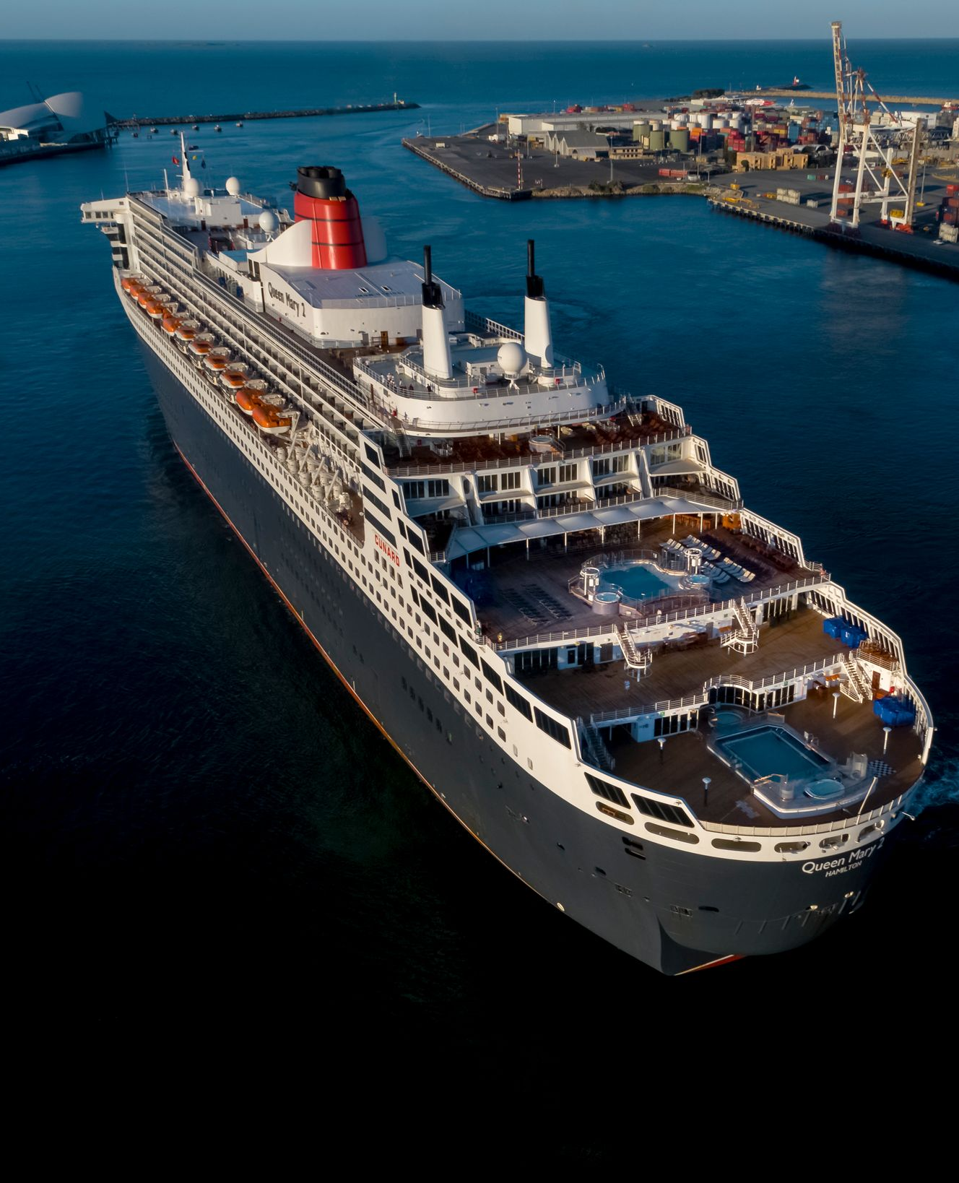
Thank you

