Slide 1
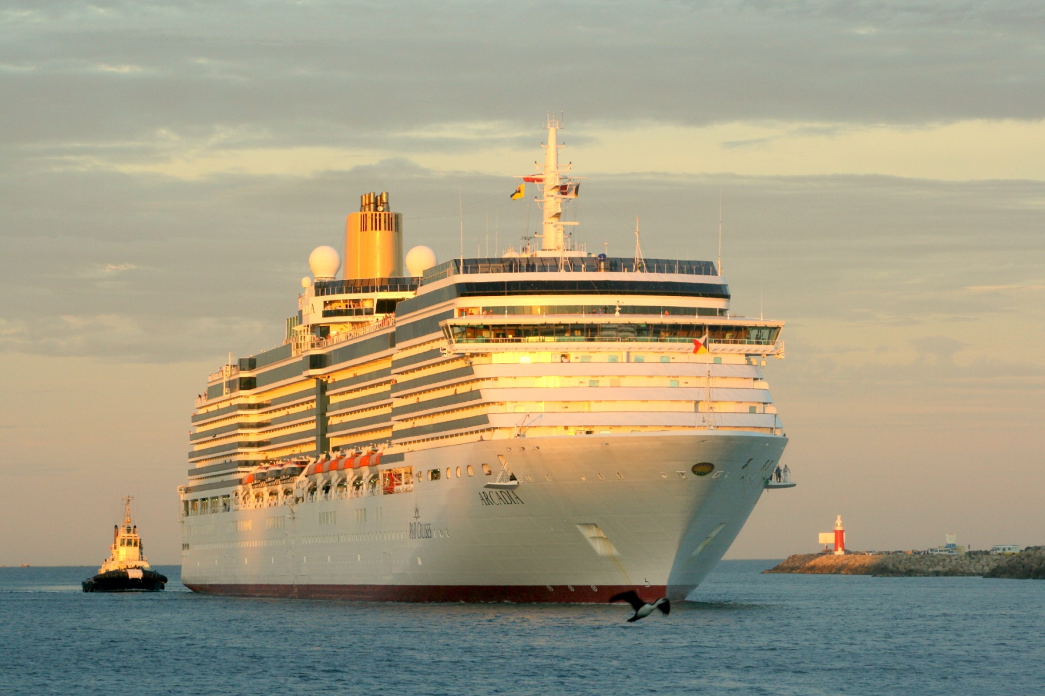

Anchoring sustainability:
A new course for cruise waste management in Australia
Rebecca James
Senior Environmental Advisor – Fremantle Ports

Slide 2

Context
We have strict biosecurity laws to protect our environment, agriculture and health from the risk of pests and diseases coming in from overseas
All waste discharged from international vessels is managed as biosecurity waste
‘Approved Arrangements’ under the Department of Agriculture, Fisheries & Forestry (DAFF) do not allow for recycling

Slide 3
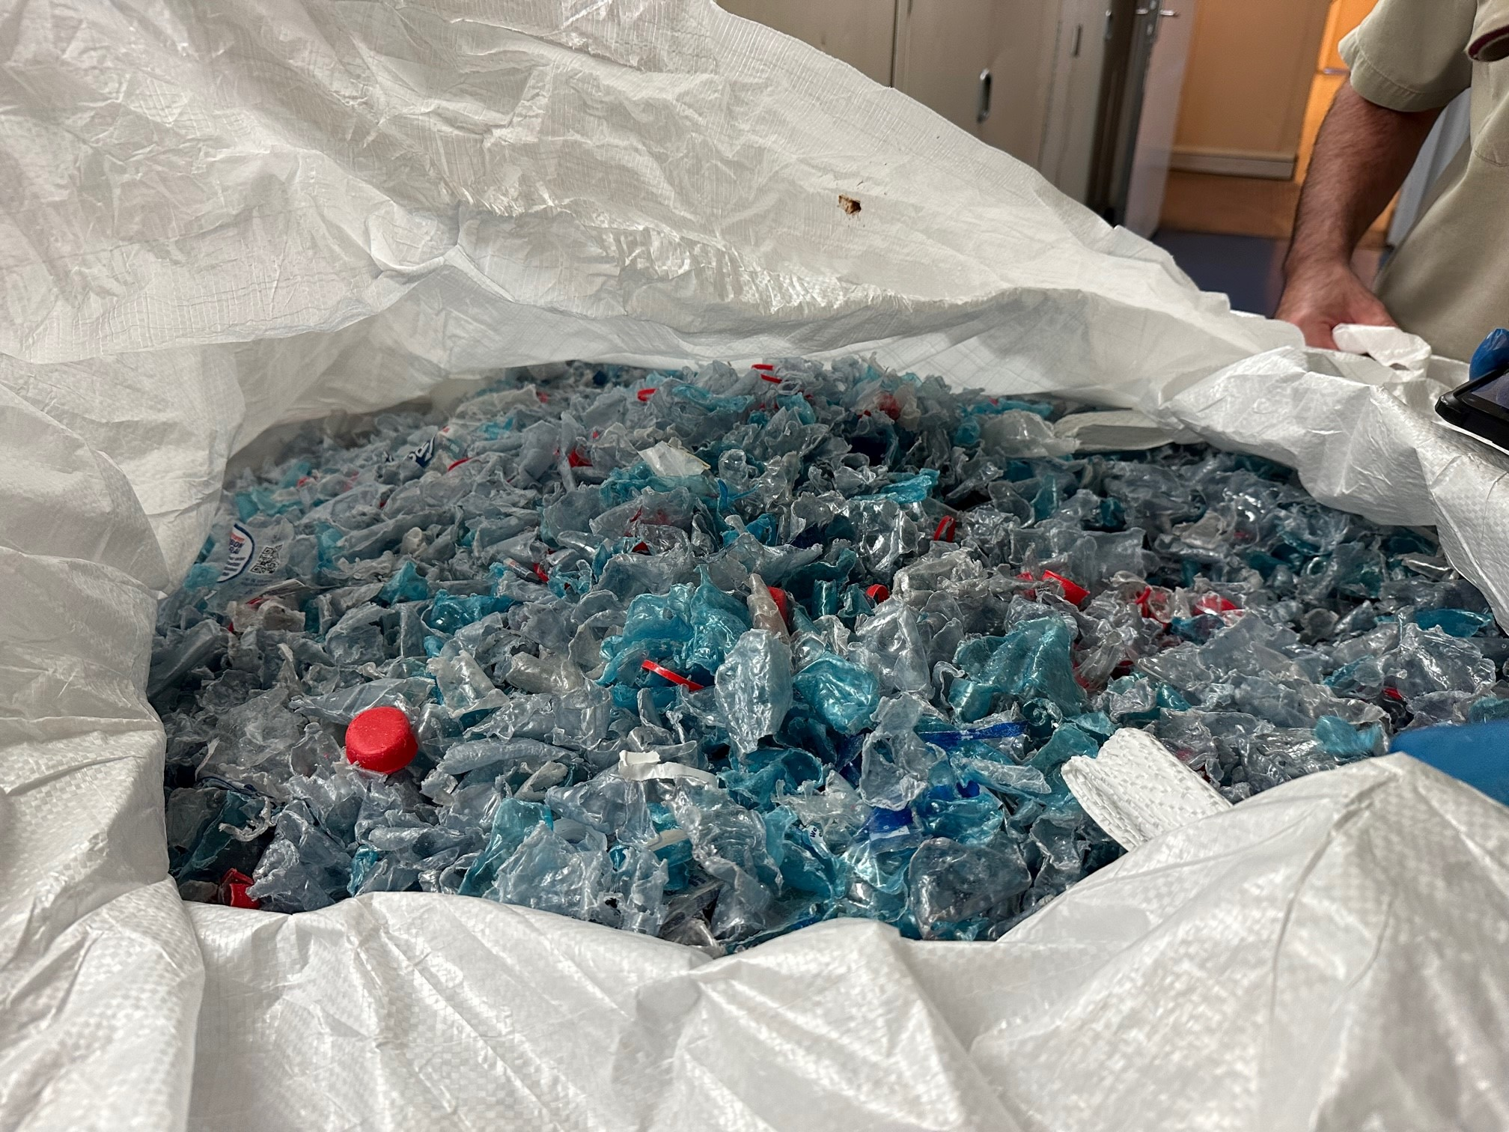
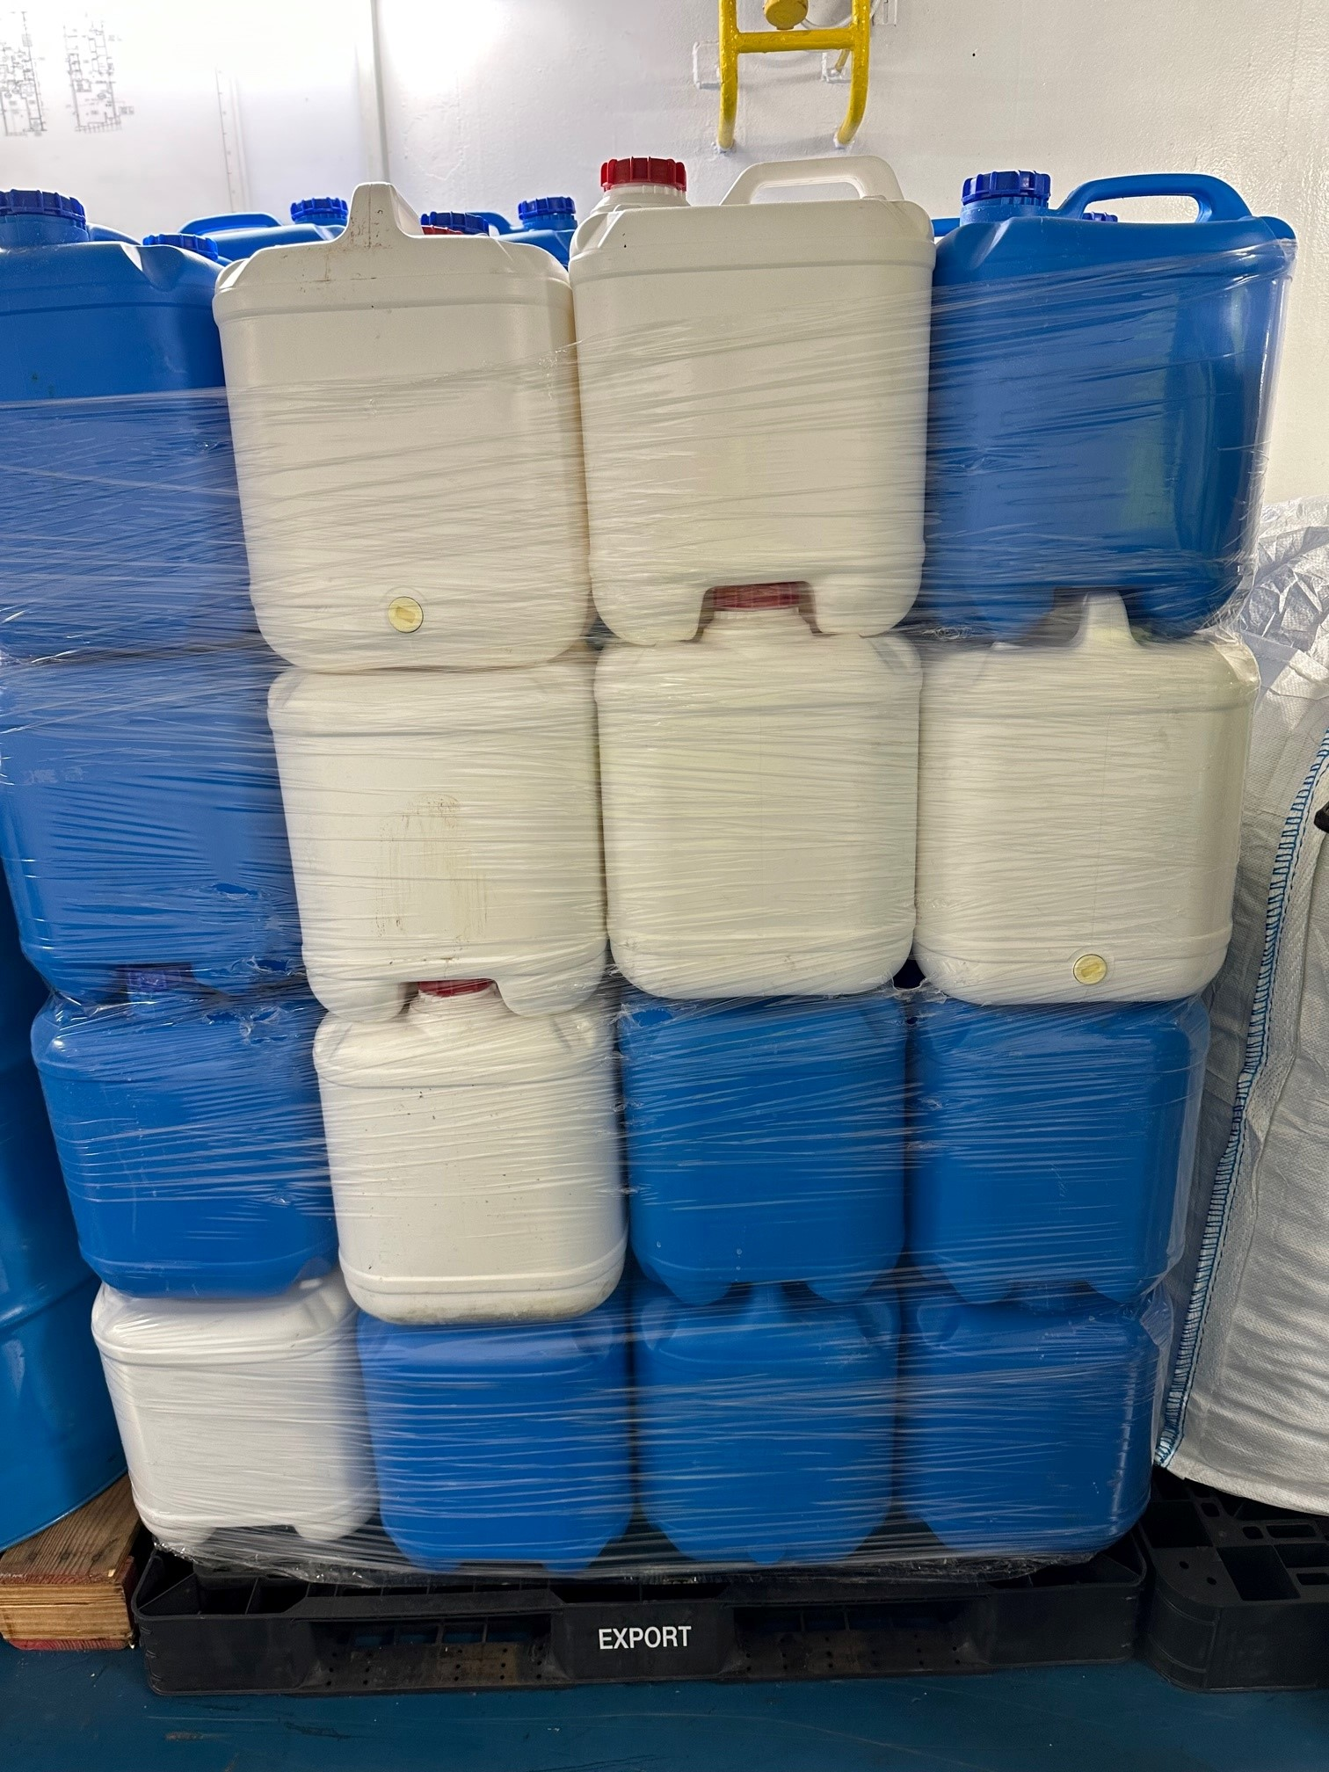
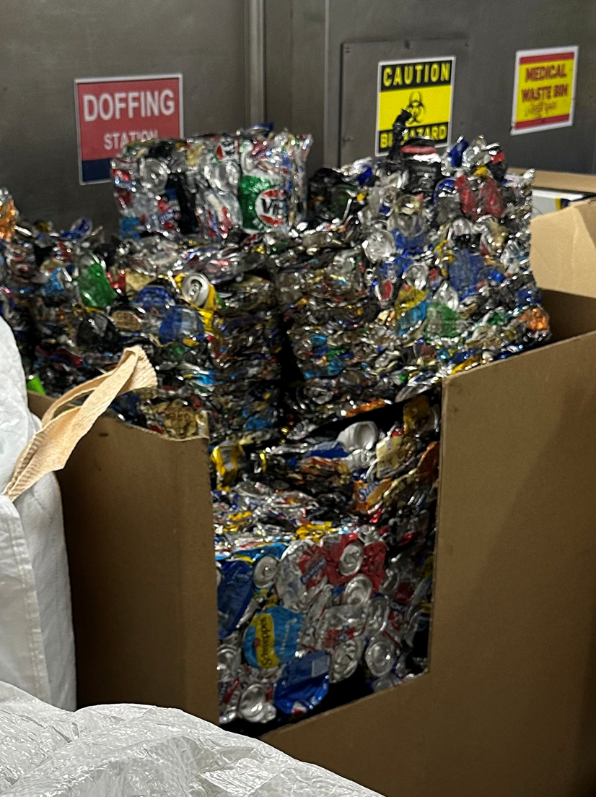
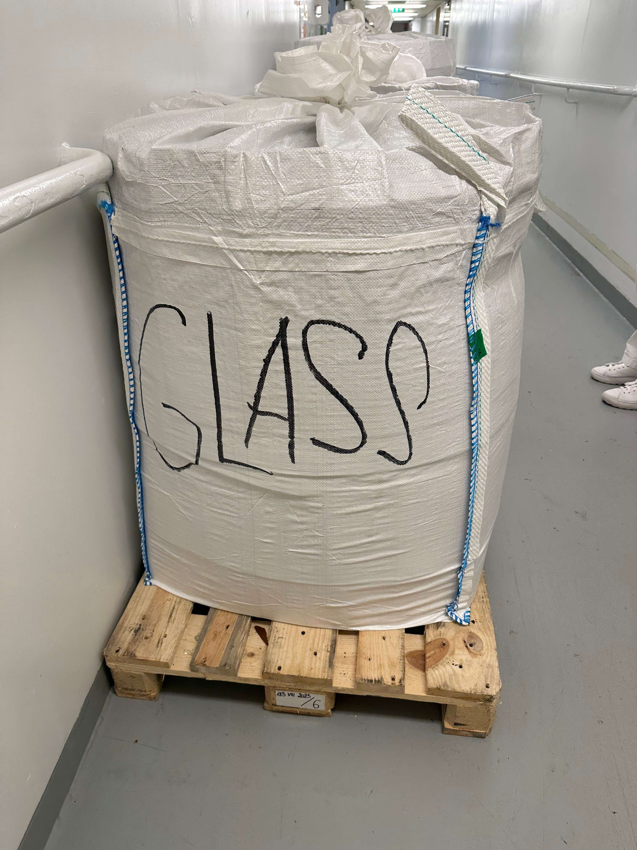
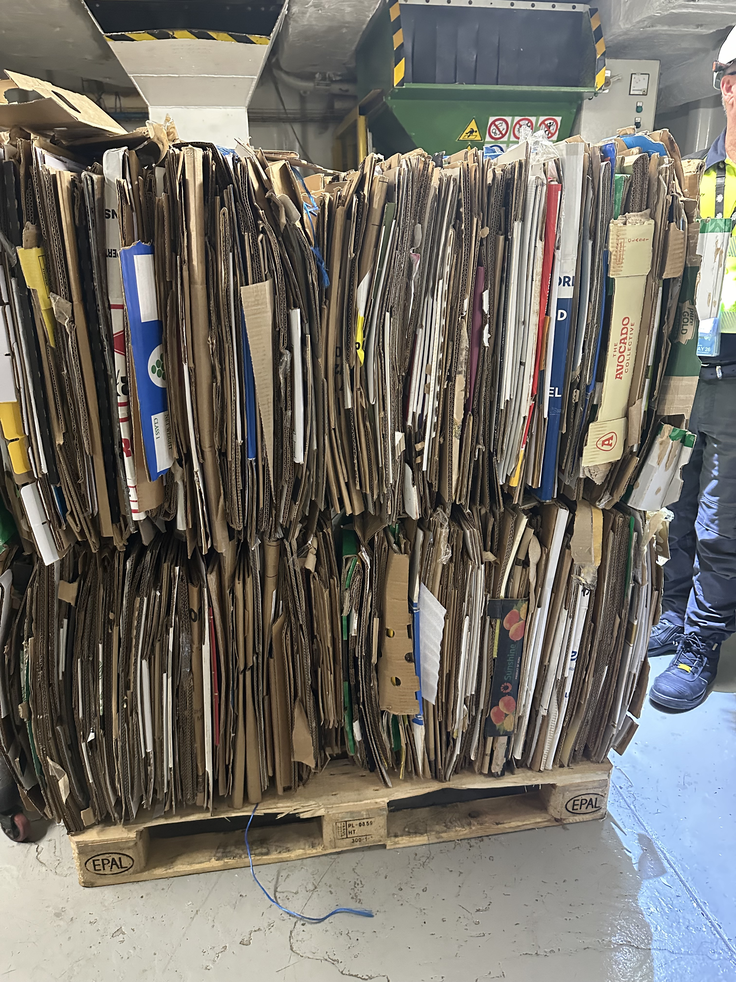
Separated cruise waste – destined for landfill!

Slide 4
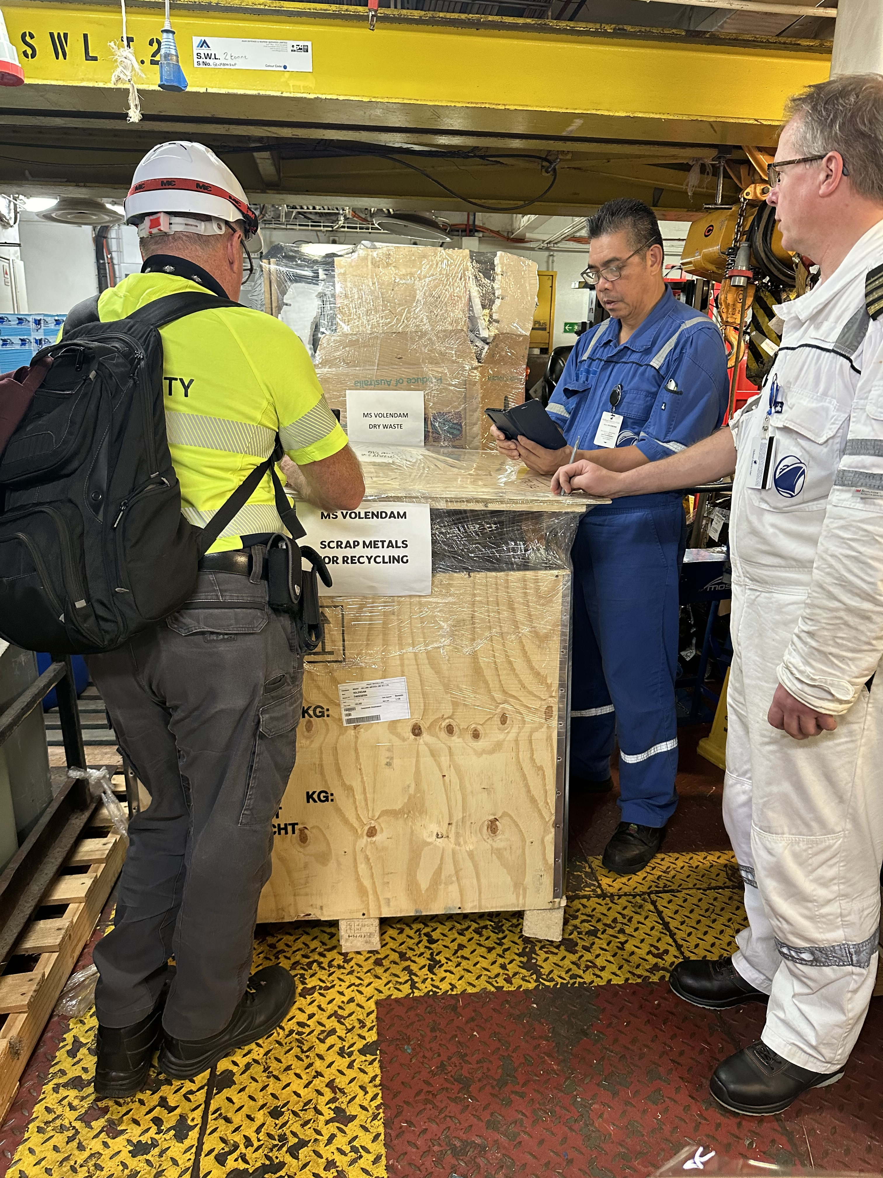
Challenging the status quo in Fremantle
Stakeholder workshops
Agreed process with local biosecurity inspectors
Pilot program in Fremantle
Started trials pre-COVID
Re-commenced November 2023

Slide 5
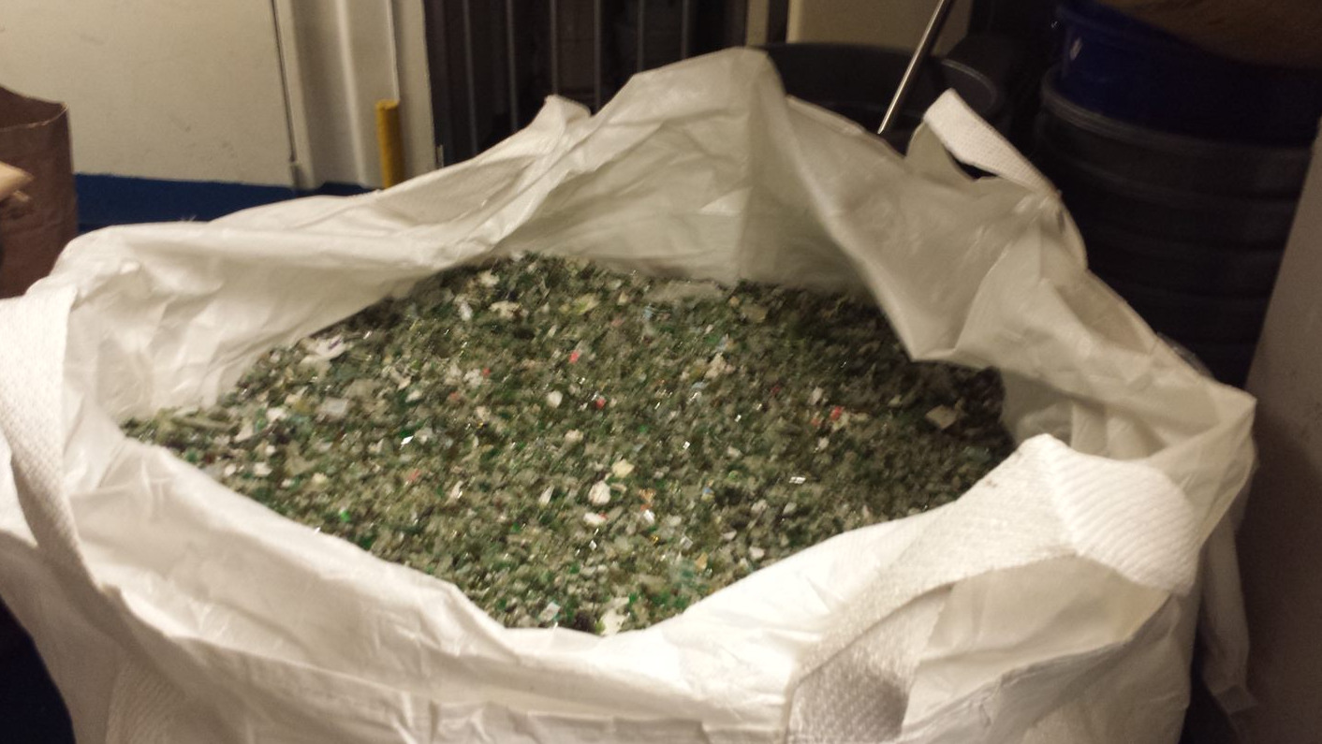
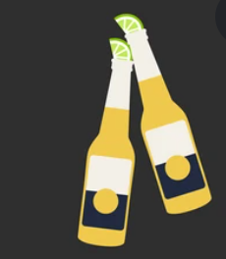
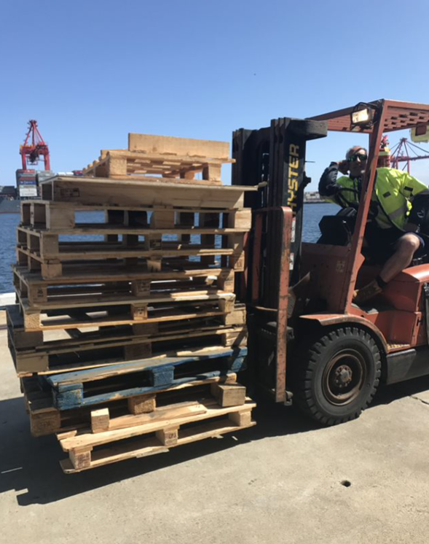
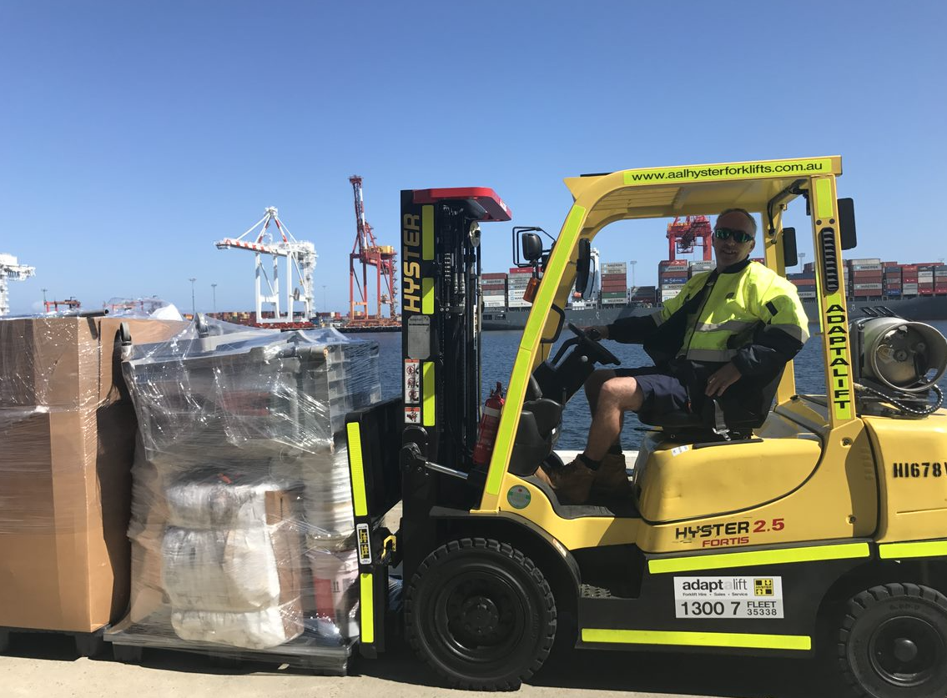
Hurdles
Multiple stakeholders/time zones
Inconsistent arrangements
Biological contamination
Timber pallets
Waste service logistics

Slide 6

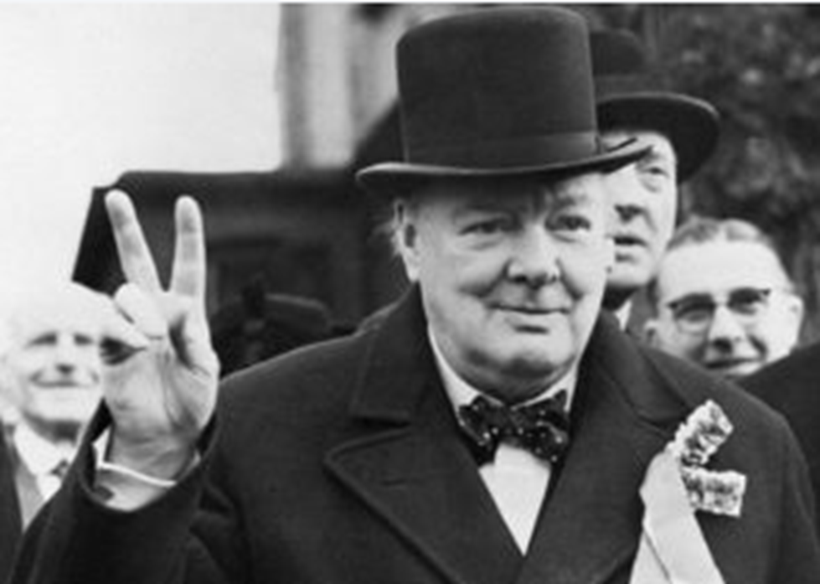
Churchill Fellowship
Singapore
London
Dover
Southampton
Antwerp
Rotterdam
Copenhagen
Los Angeles
San Francisco
Seattle
Juneau
Vancouver

Slide 7
Waste & Recycling Port Operations

Slide 8
Waste Facilities

Slide 9
Regulatory authorities and other agencies

Slide 10
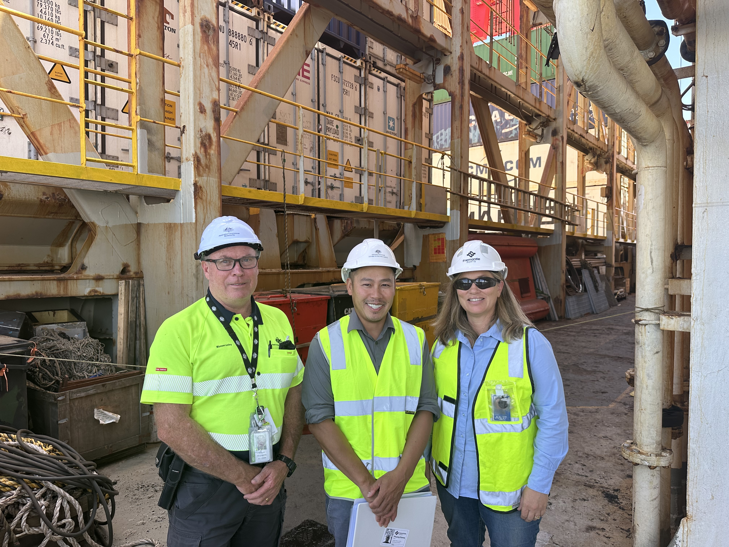
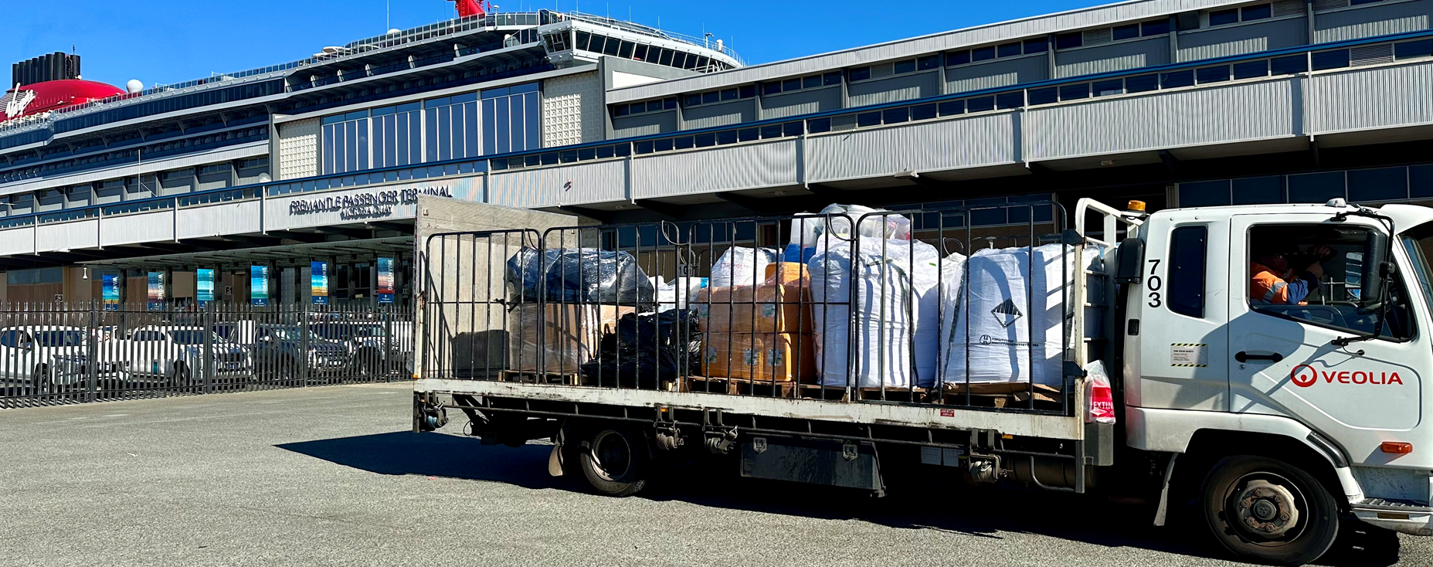
National recycling trials
Australian Maritime Safety Authority (AMSA) and
Department of Agriculture Fisheries & Forestry (DAFF)
Maritime Recycling Risk Assessment Trial
DAFF Maritime Waste Recycling Pilot

Slide 11
Status of recycling
Ongoing ‘pilot’ ships must register to participate
DAFF national policy development
Recycling inspections only guaranteed at First Point of Entry
Limited to ‘aluminium, plastic beverage containers, hard plastic containers, glass bottles and jars, tin and steel cans, clean cardboard and paper’
Inconsistencies around how operational (non kitchen) recyclables managed such as pallets, scrap metal, redundant equipment, and e-waste

Slide 12
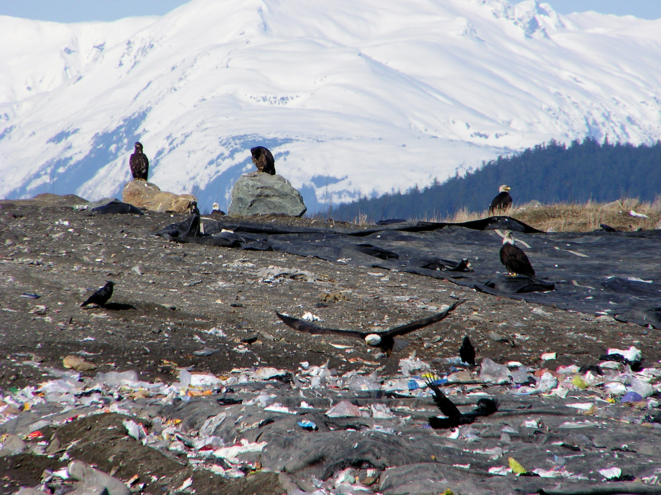
Cautionary tales from Alaska
Photo credit:
City and Borough of Juneau

Slide 13
Opportunity
Churchill Fellowship report recommendations:
Plan for sustainable cruise destinations
Establish cruise ship limits based on economic, social and environmental factors
Develop destination sustainability guidelines or codes of practice
Facilitate transition away from single use items on board cruise ships and in associated landside partner operations
Include waste infrastructure planning in the development of new cruise ports
Determine destination carrying capacities and consider cruise ship and passenger number limits based on economic, social and environmental factors, prior to critical tipping points being reached
Supports Strategy F2.1 of the Western Australian Cruise Tourism Strategic Plan 2023-2033
“Understanding, assessing, and establishing the cruise passenger carrying capacity at destinations.”

Slide 14
Role of Waste-to-Energy
Divert residual biosecurity waste from landfill
Incorporate biosecurity waste in WtE generation projections and approvals
WA - Kwinana and Rockingham
In consideration across the country: Queensland, Victoria, NSW recently out for comment

Slide 15

National roundtable 18 November - Adelaide
Recycling of ship generated waste
Waste Prevention
Waste-to-Energy
Cost recovery systems
Port Waste Management Plans for ship generated waste
Global Integrated Shipping Information System (GISIS)
Data collection
Research

Slide 16
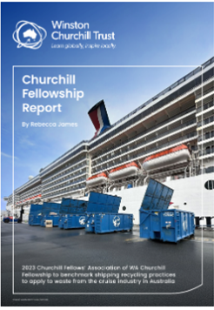
Thank you
rebecca.james@fremantleports.com.au
churchilltrust.com.au/fellow/rebecca-james-wa-2023

