Slide 1
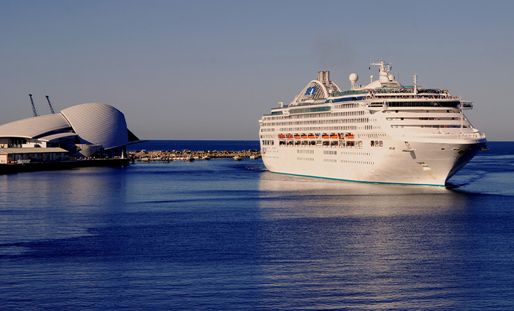

Global State of the Cruise Industry
Joel Katz - Fremantle – Sep 2025
Australian Cruise Association Conference

Slide 2
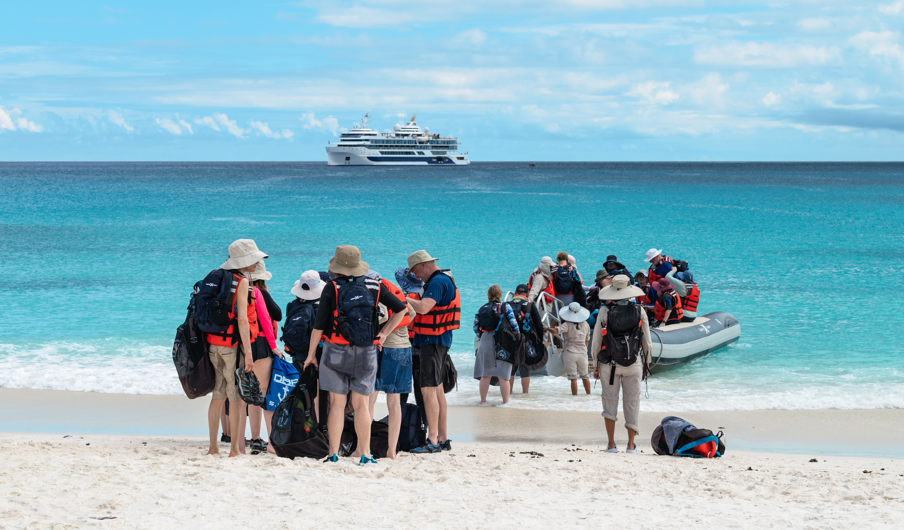
A United Cruise Community
Strength in Community – drawing great strength from the
dedication and advocacy of our industry partners.
Unified ACA/CLIA Voice – Together we ensure government
and stakeholders hear a clear and consistent message.
Shared Growth – Collaboration delivers lasting benefits for
our industry, destinations, and local communities

Slide 3
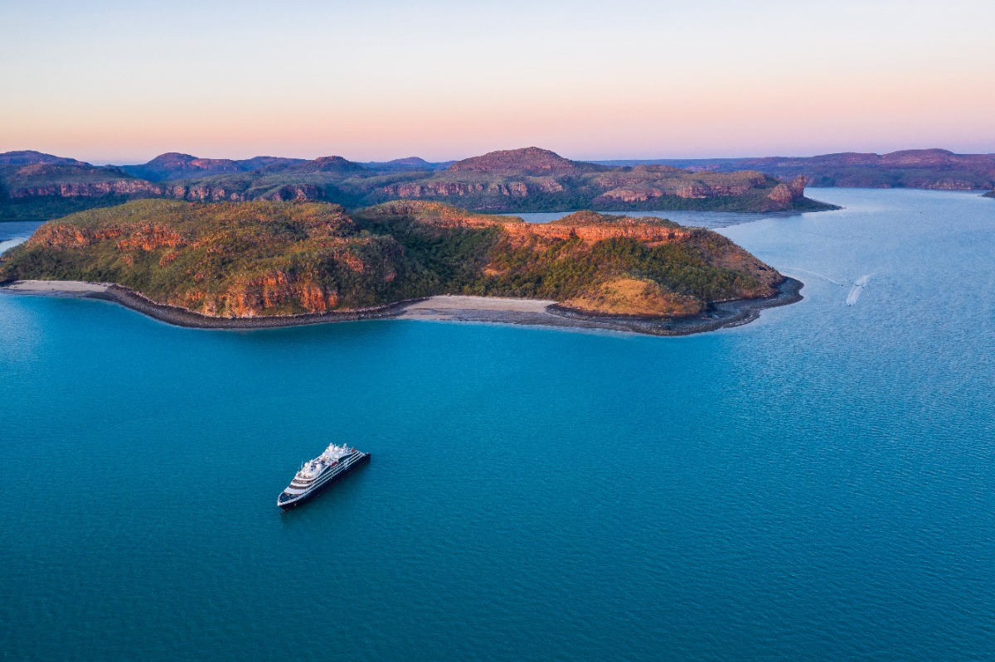
Millennials and Gen Z are more likely to travel solo than other generations.
Cruising is Thriving Worldwide
34.6 million ocean cruise passengers last year
Strong growth in first-time and younger cruisers
Intent to cruise remains at high levels
This global momentum creates new opportunities for Australia
82% of cruisers will cruise again
68% of international travellers are open to cruising
10 -13
Source: CLIA Sentiment, Perception and Intent Survey (March 2024)

Slide 4
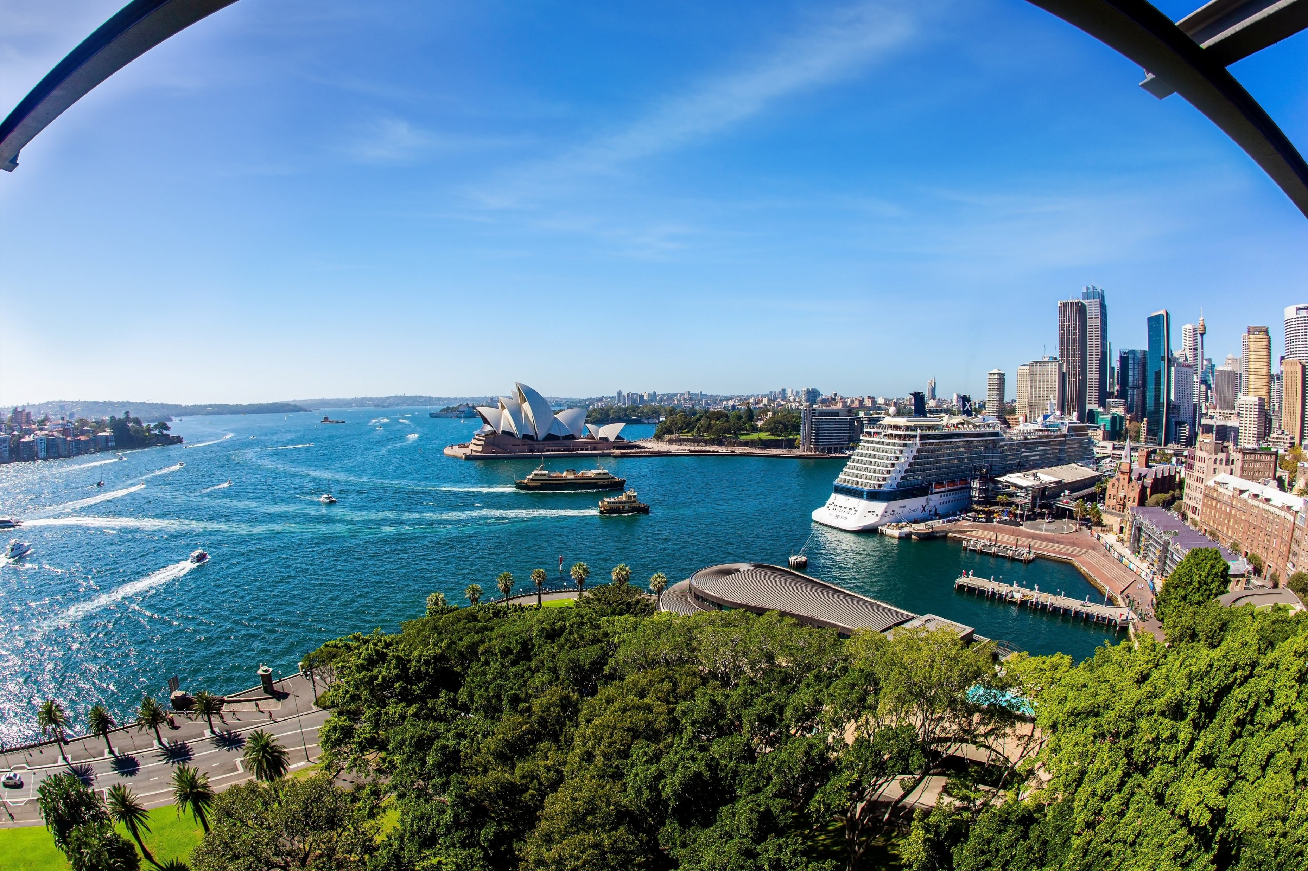
Changing Cruise Demographics
Nearly one-third first-time cruisers (up from 25% in 2019)
Gen-X & Millennials leading interest
Average age 46.5; over one-third under 40
Growth in multi-generational and repeat cruising

Slide 5

A Cleaner, Smarter Global Fleet
81 new ships on order through 2036 (US$70B)
Strong support from the investment community
Focus on LNG, methanol, biofuels & hybrid tech
Net-zero emissions by 2050 is the industry's goal
Cruise ships among the cleanest vessels at sea
Industry investing in cleaner energy & port partnerships

Slide 6

Millennials and Gen Z are more likely to travel solo than other generations.
Path to Net Zero
Sustainable fuels: LNG, methanol, biofuel, hydrogen, hybrid
Advanced efficiency: air lubrication, waste heat recovery, hull
coatings, smart energy management
Advocacy for sustainable infrastructure investment
AU needs supportive port and fuel infrastructure to benefit
10 -13
Source: CLIA Sentiment, Perception and Intent Survey (March 2024)

Slide 7
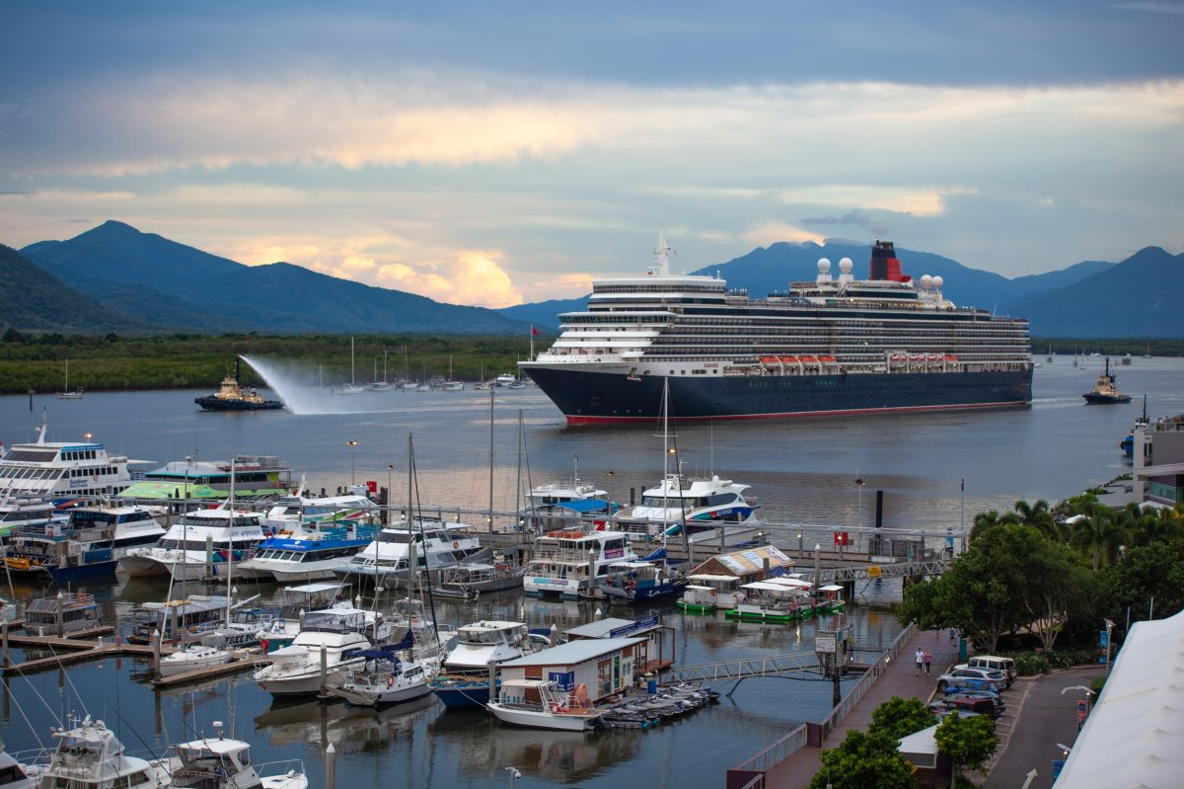
Millennials and Gen Z are more likely to travel solo than other generations.
Responsible Cruise Tourism
Destination Stewardship: supporting long-term sustainability
Community Collaboration: aligning with local goals
Cultural Respect & Economic Contribution
Environmental Care & Transparent Governance
10 -13
Source: CLIA Sentiment, Perception and Intent Survey (March 2024)

Slide 8
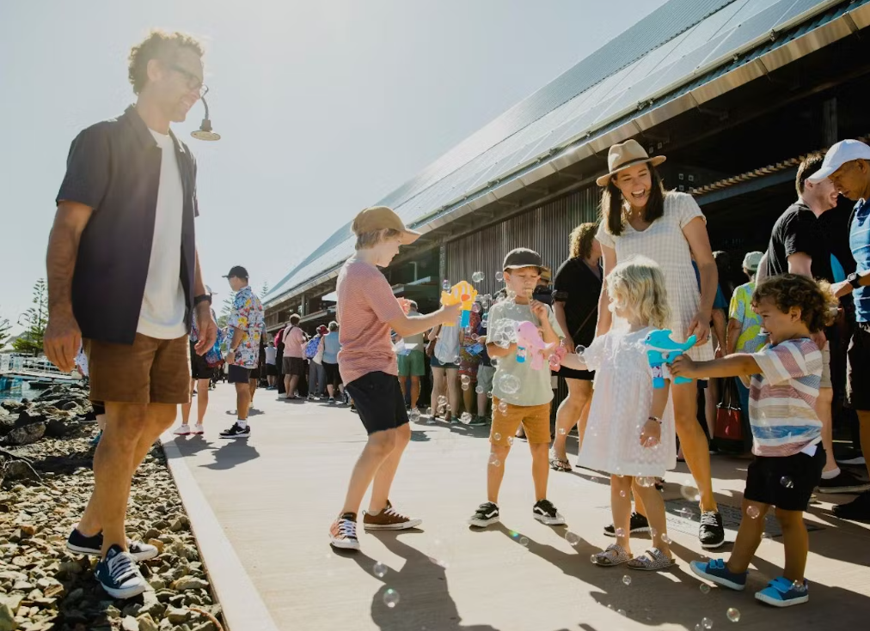
Supporting Regional &
Coastal Economies
Up to 100% local provisioning in some destinations
Jobs across transport, hospitality, retail & supply chains
Meaningful spend from guests, crew & cruise lines
Focus on ensuring benefits stay in the community

Slide 9
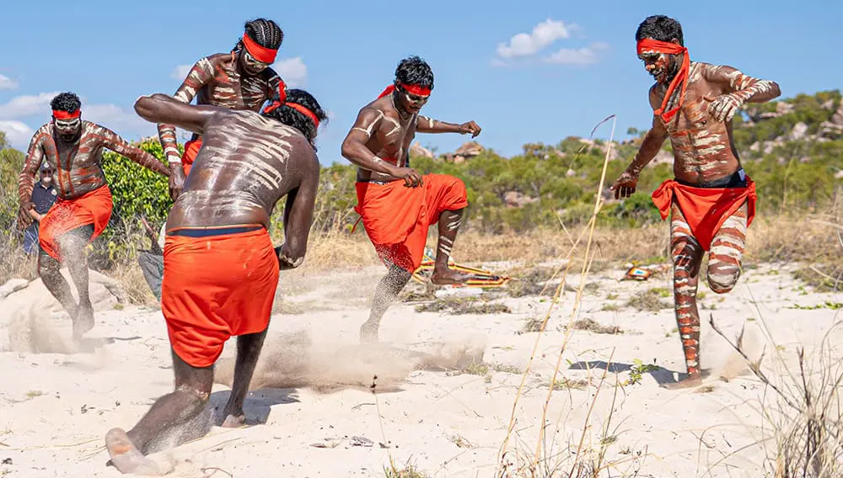
Respecting Culture
Tourism must be community-led and collaborative
Cruise can be a positive force: economic, cultural, environmental
Shared planning yields resilient, proud, thriving destinations
Together, we shape a tourism model that uplifts people and place
Supports cultural exchange and resilience
Builds economic opportunities in remote areas

Slide 10
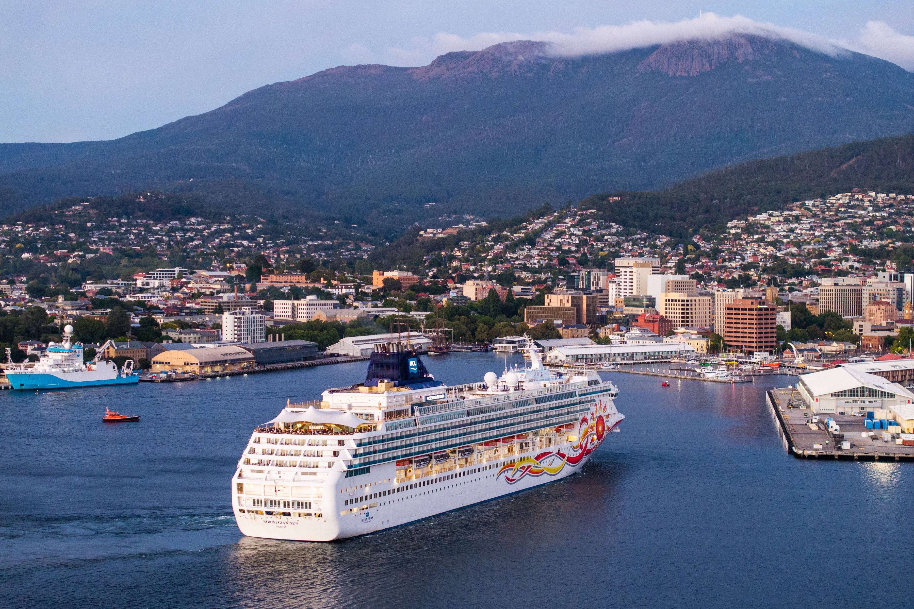
Why Advocacy Matters
CLIA is focused on securing the right regulatory settings to support growth.
Advocacy and government affairs are at the heart of our work.
Australasia remains an expensive and complex operating region.
Rising costs and regulations are reducing competitiveness and visitation.
Action is needed to improve the operating environment and retain ships

Slide 11

.
Progress & Priorities
Positive results from determined advocacy efforts.
Strong support voiced in NZ
Building momentum in Australia across federal, state,
and local levels
Collaboration with cruise lines, ports, local communities,
State & Territory Govts, and Federal agencies

Slide 12
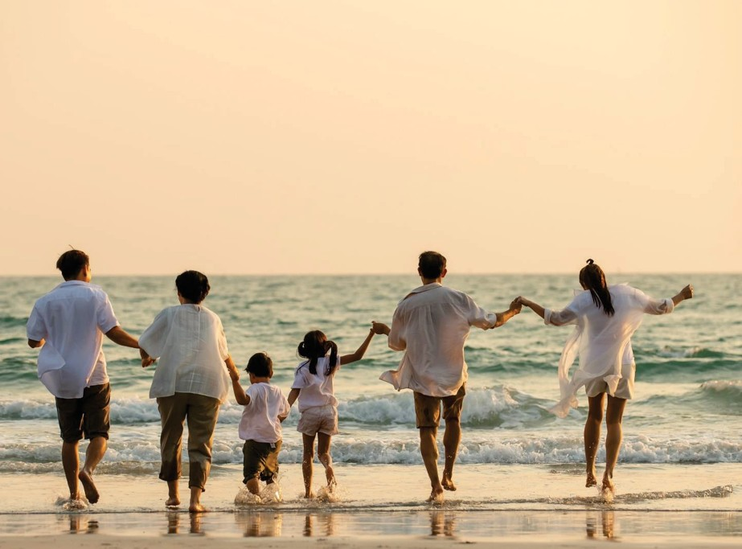
Millennials and Gen Z are more likely to travel solo than other generations.
Strengths and Opportunities
63 cruise ships will visit Australia this summer
Hundreds of thousands of passengers across all coastal states and territories
Passenger numbers grew to 1.3m last year – one of our best ever results
Australasia is one of the world’s most passionate and committed cruise regions
Innovation, creativity, and unforgettable guest experiences continue to drive growth
10 -13
Source: CLIA Sentiment, Perception and Intent Survey (March 2024)

Slide 13

Thank You
www.cruising.org.au

Slide 14

Stewardship for the Future
Cruise success depends on partnerships ashore
Managed tourism can be a positive force
Shared planning builds stronger destinations
Together, we protect people, place, and planet

