Slide 1
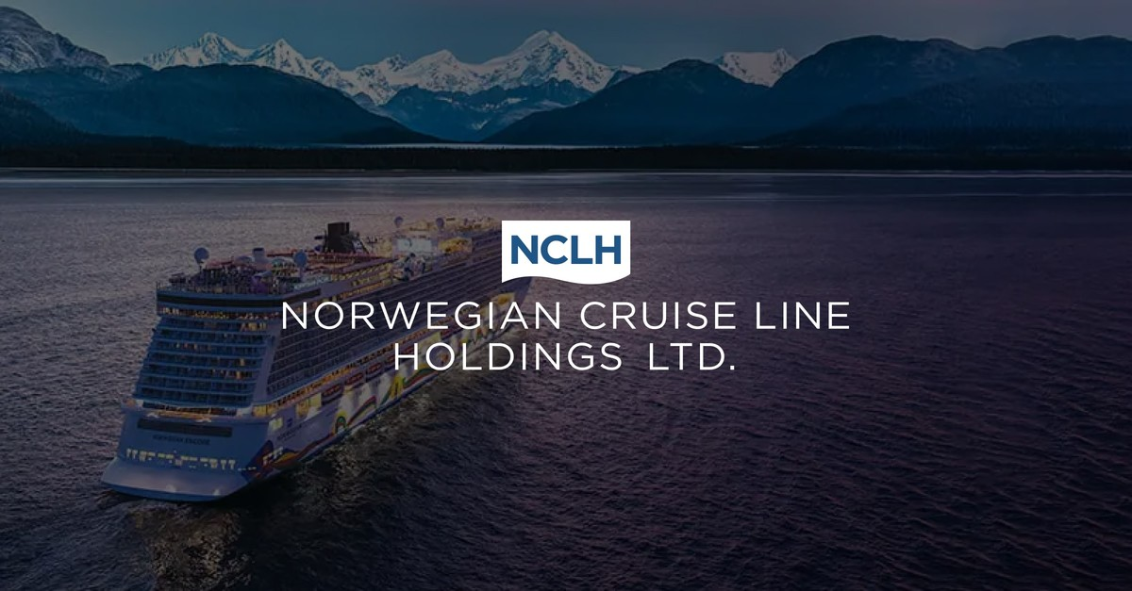
Redesigning Shorex for Different Generations
By Christine Manjencic

Slide 2
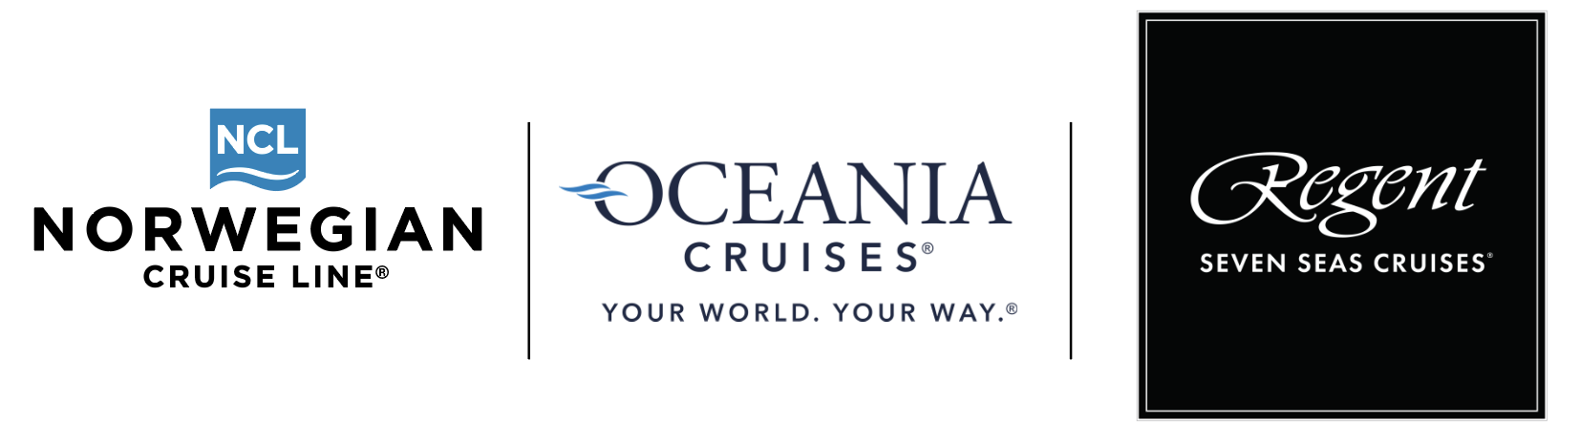

Slide 3
Redesigning Shorex for Different Generations
At NCLH we have the Contemporary customer, the Upper Premium and the Ultra Luxury Clientele.
Asking yourself about the customer …. Knowledge about the customer is key to whether you offer activities for a first-time visitor or not, educational or explorational.
Generations today live on Social Media and then telling the world they are traveling or doing something cool is a bragging tool, so its finding something they can share on Social Media.
Stepping up the game and curating experiences that guests cannot find on google.
Identifying the Customer
Differentiating the Products offered
Experiences with Bragging rights and what’s trending
Finding that unique experience that you cannot find on google

Slide 4
Redesigning Shorex for Different Generations
Who or What is our biggest Competition? ….. But can still be used to our advantage?

Slide 5



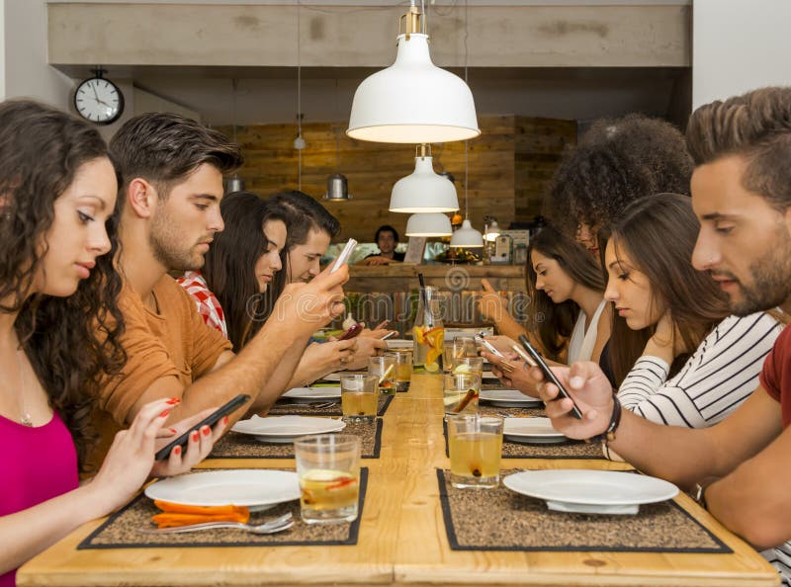


Redesigning Shorex for Different Generations – Understanding the Competition

Slide 6
New Shore Excursions Created by the NCLH Product Team
Between 3 brands we have over 16,757 active tours per year.
Our most popular coach tours done exactly the same but with smaller groups, min 10 per group and maximum 16 per group, set with premium pricing, launch on all brands.
Best selling new concept – Combining Travel with Social Media – 6 Cruise Lines picked this up after development, launched now as “Capturing the Moment” on OCI and RSSC.
Needed capacity in areas that have shortages in licensed guides, following the itinerary of a Highlights tour but with an escort and the stop are OYO
More local experience focused. Travel Weekly Article and Wall Street Journal featured these tours for OCI as best new additions.
Small Group Tours
Let’s Take a Selfie
Highlights OYO
Go Local Tours

Slide 7
Redesigning Shorex for Different Generations
NCLH – Guests on tour
- 4.400.000
2023 - 5.200.000
2024 - 5.800.000

Slide 8
Top travel trends for 2025
Prioritizing eco-friendly initiatives, there is a growing interest in nature and outdoor experiences.
More food-focused and cultural immersion activities.
Social status is a driver for the choice of experience in younger generations.
Technology plays a bigger role, with AI adoption increasing and virtual reality used to showcase destinations.

Slide 9
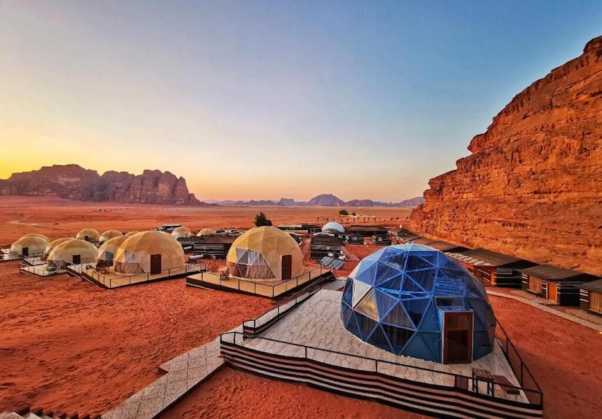
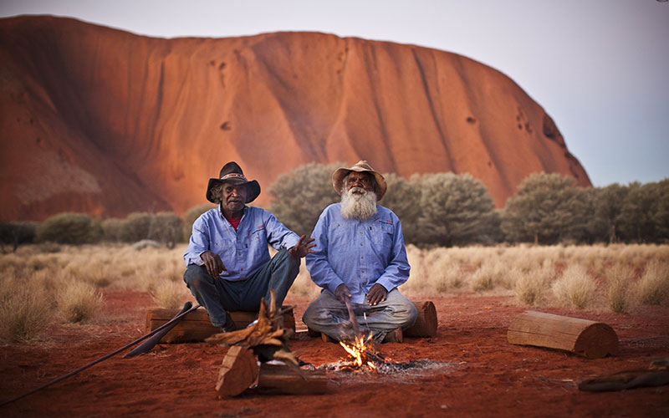
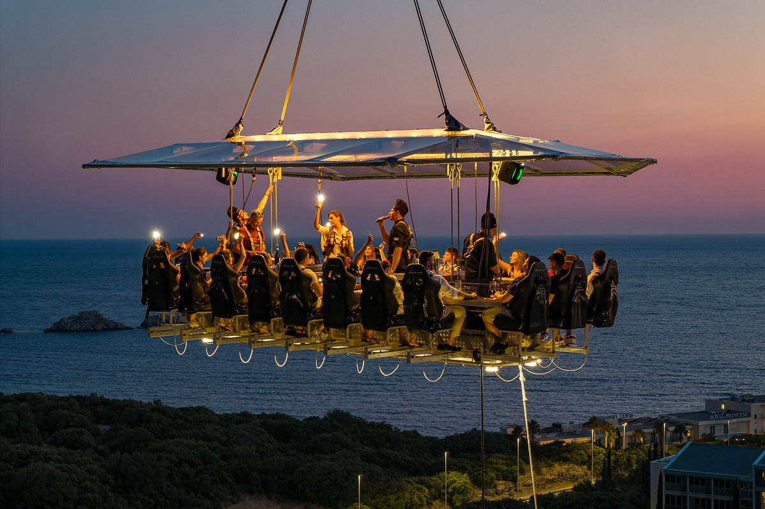
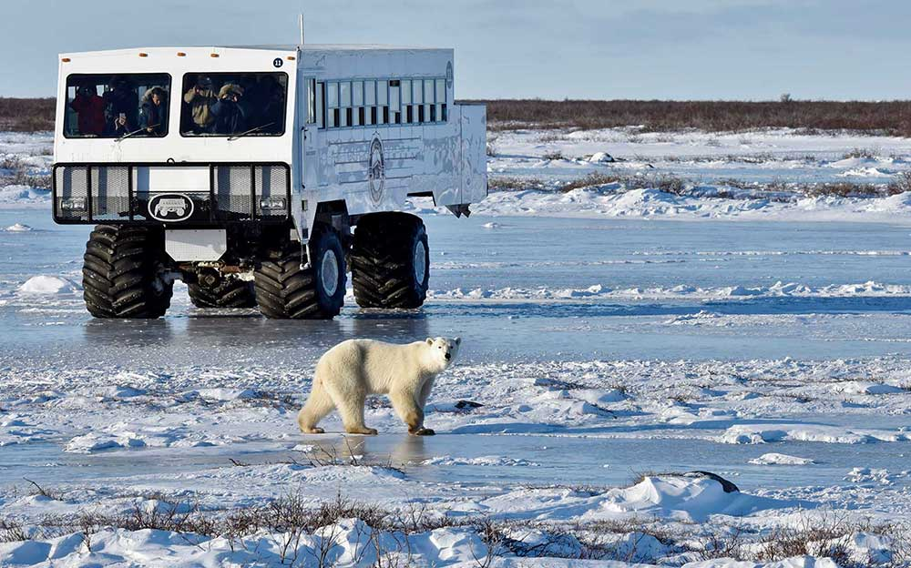
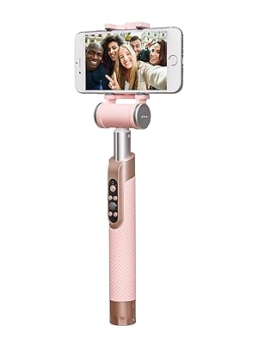
The New Frontier of Travel is on the Horizon

Slide 10
Thank you

